Slide 1


SupplyShield AI
Enterprise Supply‑Chain Operations Intelligence
Team: Jetha Ke Jaanbaaz · Track: IBM Bob AI Hackathon — AI Track
Members: Neel Gohil · Jenish Jadav · Vaibhav Chavada · Jaimeen Gondaliya · CHARUSAT
Jetha Ke Jaanbaaz — footer

Slide 2

Problem: Supply chains are flying blind during disruptions
- Operators manually cross‑reference carrier feeds, maps, and cargo sensitivity under stress
- Time to assess an incident: 30–60 minutes — costly delay for perishable goods
- Cold‑chain excursions often detected only at delivery; products compromised
- Idle vehicles remain unused because no link exists between disruptions and nearby assets
Jetha Ke Jaanbaaz — footer

Slide 3

Solution: One intelligent command center — detect, score, monitor, act
SupplyShield AI unifies disruption detection, deterministic risk scoring, cold‑chain monitoring, idle‑fleet surfacing, and grounded AI recommendations powered by IBM watsonx.ai (Granite). All AI suggestions are evidence‑backed and require operator approval.
Jetha Ke Jaanbaaz — footer

Slide 4
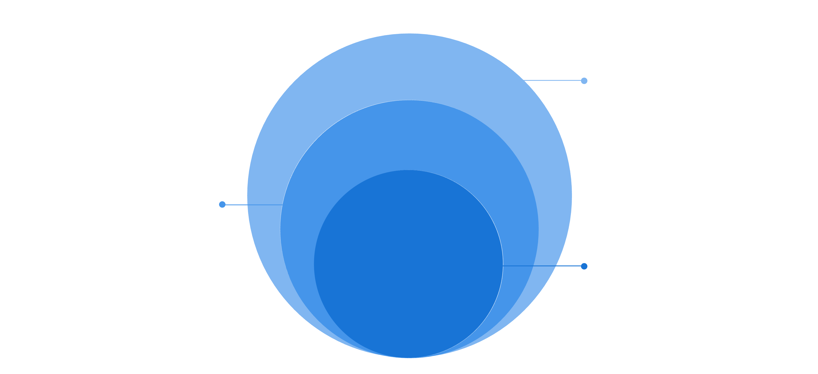
Architecture overview
Data & AI Services
Postgres (Supabase) and Python boundary to IBM watsonx.ai
Backend API
ASP.NET Core verifies facts, no IBM SDK
Frontend
React app sends user requests
Key rule: ASP.NET Core never imports IBM SDK — AI only receives verified facts via the Python service boundary.
Jetha Ke Jaanbaaz — footer

Slide 5

Disruption Intelligence
Detect active disruptions: weather, port congestion, road closures, carrier incidents
Auto‑link disruptions to affected routes and shipments
Deterministic risk score from severity, priority, expected delay, cold‑chain state, route risk
No AI in risk scoring — rules-based for predictable, auditable outcomes
Jetha Ke Jaanbaaz — footer

Slide 6

Cold‑Chain Monitoring
Per‑shipment sensor tracking (sensor_code, min/max thresholds)
Deterministic excursion severity: MEDIUM / HIGH / CRITICAL; configurable per sensor policy
1‑click alert acknowledgement with full audit trail
Time‑series temperature retention for compliance and forensic analysis
Jetha Ke Jaanbaaz — footer

Slide 7

Fleet Redeployment Intelligence
Surface idle/available vehicles automatically when disruptions occur
Redeployment ranking by capacity, proximity, and vehicle‑cargo compatibility
Assignment history tracked for auditing; no automatic consequential assignment
Operator approval required for every redeployment action
Jetha Ke Jaanbaaz — footer

Slide 8

Grounded AI — IBM watsonx.ai (Granite) integration
AI only receives backend‑verified facts (disruptions, scores, sensors)
Model produces evidence‑linked explanations; never invents IDs, ETAs, temps, or costs
Responses include supporting facts shown to operator alongside suggestion
IBM Bob served as primary development partner throughout the project
Operator Input
Backend Verification
Call Granite
Evidence & Confirm
Jetha Ke Jaanbaaz — footer

Slide 9

What‑If Simulation Engine
- Run side‑by‑side comparisons: live route vs alternative (ETA, cost, risk delta)
- Simulations operate on verified backend snapshots; live operations are NOT mutated
- Supports carrier alternatives, reroutes, and multi‑leg segment comparisons with deterministic risk recalculation
- Results surfaced as a clear delta view for operator decisioning
Jetha Ke Jaanbaaz — footer

Slide 10




Tech stack
Backend
Generative AI
ASP.NET Core 10 · C# · Entity Framework Core
IBM watsonx.ai — Granite (via Python service)
- Python 3.11, FastAPI for AI service; scikit‑learn for auxiliary models
- Testing: xUnit (backend), tsc + Vite build (frontend)
- Realtime (Phase 1+): ASP.NET Core SignalR
- IBM Bob: development partner for architecture, code generation, and reviews
Database
Frontend
Supabase PostgreSQL
React 18 · TypeScript · Vite · Recharts
Jetha Ke Jaanbaaz — footer

