Slide 1

SpamShield
Detecting spam messages with machine learning
5,572 messages · 4 models · 98.2% best accuracy
Notes:
SpamShield is a machine-learning project that classifies text messages as spam or ham (legitimate). We'll go through the data, the preprocessing pipeline, four models, and what the results really tell us, including where the model still fails.

Slide 2



The problem
Goal
Approach
Key question
Label every message as ham (legitimate) or spam
Clean the text, turn it into TF-IDF features, train four classifiers
Which model catches the most spam without blocking real messages?
Notes:
Spam wastes time and can carry scams. The goal here is a binary classifier: ham or spam. The real question isn't just which model is most accurate, but which one catches the most spam without blocking real messages.

Slide 3
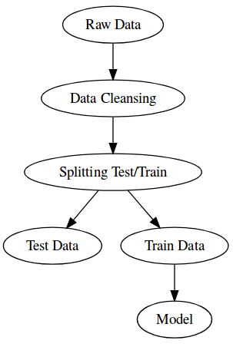
Machine Learning Approach

Slide 4
The dataset
5,572
SMS messages, no missing values
4,825
ham: legitimate messages
747
spam: 13.4% of the data
Imbalanced classes: accuracy alone can hide missed spam
Notes:
The notebook loads a public SMS collection: 5,572 labelled messages, no missing values. Only about 13% are spam, so the classes are imbalanced. That matters later: accuracy alone can hide missed spam.

Slide 5
Spam looks different
Characters per message
Words per message
Punctuation marks
71.5
138.7
14.3
23.9
3.9
5.7
Ham (avg)
Spam (avg)
Ham (avg)
Spam (avg)
Ham (avg)
Spam (avg)
1.9x longer in spam
1.7x more in spam
1.5x more in spam
Spam clusters near 150 characters; most ham is far shorter (median 149 vs 52).
Notes:
Even before modelling, simple features separate the classes. On average spam is about twice as long, has more words, and more punctuation. Median spam length is 149 characters versus 52 for ham, so spam clusters near 150 characters.

Slide 6
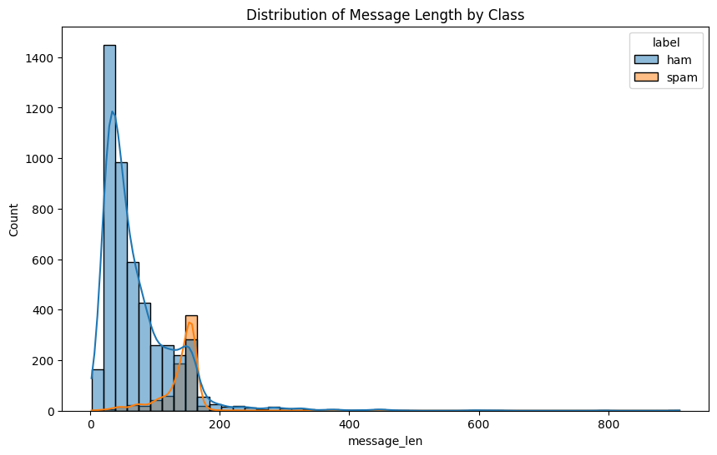

Slide 7
Words give it away
Top spam words
Top ham words
Fillers like “u”, “ur”, “2” excluded
Notes:
Spam leans on calls to action: call, free, txt, claim, reply, stop. Ham is conversational: get, go, like, come, know, good. Note 'call' appears in both, which is why a model needs more than a keyword list. Filler tokens like 'u', 'ur' and '2' are left out of the charts.

Slide 8
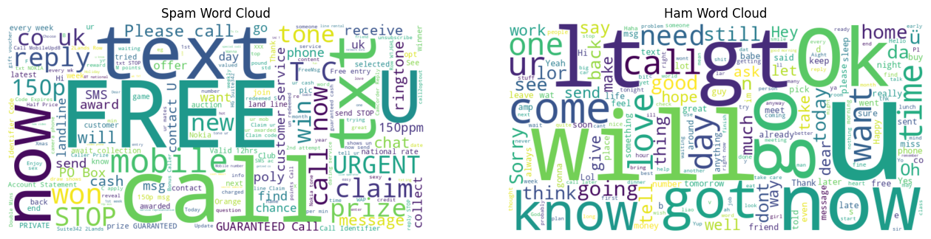

Slide 9
From raw text to features
1
2
3
4
5
6
Lowercase
Remove punctuation
Tokenize
Drop stopwords
Porter stemming
TF-IDF (5,000 features)
Before
80 / 20
Go until jurong point, crazy.. Available only in bugis n great world la e buffet... Cine there got amore wat...
stratified split
After
go jurong point crazi avail bugi n great world la e buffet cine got amor wat
4,457 train · 1,115 test
Notes:
Each message goes through six steps. Lowercase, strip punctuation, tokenize, remove stopwords, stem with the Porter stemmer, then TF-IDF with a 5,000-feature vocabulary. The data is split 80/20 with stratification so both sets keep the same spam ratio: 4,457 train and 1,115 test messages.

Slide 10
Four models, one pipeline
1
Naive Bayes
2
Logistic Regression
MultinomialNB
max_iter = 1000
Fast word-probability baseline
Linear model with interpretable weights
3
SVM
4
Random Forest
Linear kernel
100 trees
Maximum-margin linear separator
Ensemble of decision trees
Notes:
All four classifiers train on the same TF-IDF features and are evaluated on the same held-out test set, so the comparison is fair.

Slide 11
SVM leads on accuracy
98.2%
SVM accuracy, the highest of the four
0.971–0.984
AUC range; Random Forest highest at 0.984
Notes:
Linear SVM reaches 98.2% accuracy, ahead of Random Forest at 97.4%, Logistic Regression at 96.5% and Naive Bayes at 96.3%. AUC is much tighter, from 0.971 to 0.984, with Random Forest highest. Note the chart axis starts at 90%.

Slide 12
The catch: spam slips through
28% → 11%
spam missed: Naive Bayes vs SVM
0.97 vs 1.00
SVM trades a little spam precision for much better recall
Notes:
Every model almost never flags a real message as spam (ham recall 1.00). The difference is spam recall: Naive Bayes and Logistic Regression miss more than a quarter of spam. The SVM misses about 11%, at a small cost in spam precision (0.97 versus 1.00 for the others).

Slide 13
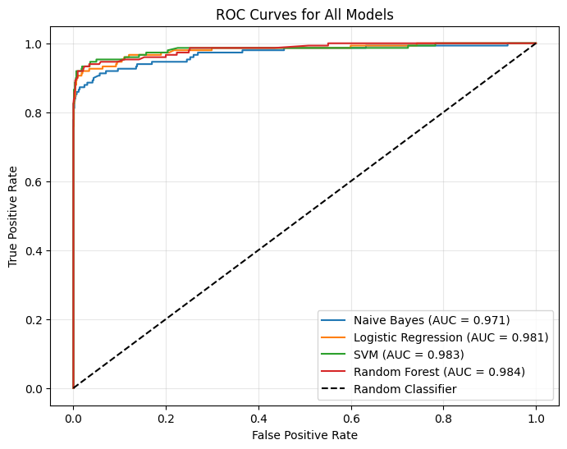
ROC curves agree
0.984
Random Forest, highest AUC
0.983
SVM, close behind
0.971
Naive Bayes, lowest AUC
Notes:
All four curves hug the top-left corner and sit far above the random baseline. The ordering by AUC is Random Forest 0.984, SVM 0.983, Logistic Regression 0.981, Naive Bayes 0.971.

Slide 14
Live test: spam still slips through
Message | Actual | Predicted | Conf.
Congratulations! You've won $1000 cash! Click here now! | Spam | Spam | 0.87 | ✓
Hey, are we still meeting for lunch tomorrow? | Ham | Ham | 1.00 | ✓
URGENT! Your account will be closed. Confirm details NOW! | Spam | Ham | 0.92 | ✗
Thanks for the report. Let's discuss in tomorrow's meeting. | Ham | Ham | 1.00 | ✓
Free money!!! Act now!!! | Spam | Ham | 0.96 | ✗
Caught 1 of 3 spam examples. Likely cause: training data is SMS-era spam, so newer phishing wording is unfamiliar.
Notes:
We tried five hand-written messages. The two normal messages were correctly marked ham, but only one of three spam examples was caught. 'URGENT! Your account will be closed' and 'Free money!!! Act now!!!' were both labelled ham with high confidence. The training data is SMS spam, so newer phishing-style wording is likely out of distribution. This matches the recall gap on the previous slides.

Slide 15
Takeaways and next steps
Takeaways
Next steps
SVM is best overall: 98.2% accuracy, 0.89 spam recall
Almost no real messages are blocked (ham recall 1.00)
About 11% of spam still gets through, even with the best model
Tune the decision threshold or class weights to raise spam recall
Add newer and more varied data, including phishing and email
Try n-gram features or a transformer model
Notes:
Linear SVM is the best overall on this split: 98.2% accuracy and the highest spam recall at 0.89. But roughly one in ten spam messages still gets through, and hand-written phishing-style examples were missed. Next steps focus on recall and on broader data. The notebook also saves the model and vectorizer with pickle so it can be reused.

