Slide 1


Slide 2
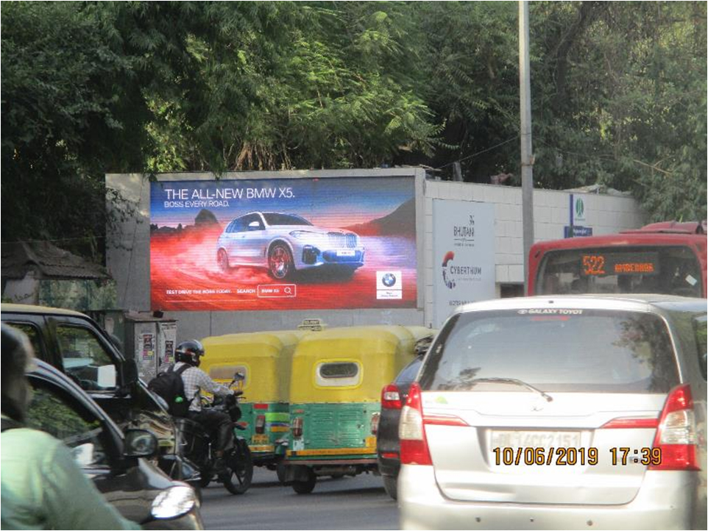
Name : CP Outer Circle (Chemsford Turning)
Media Type : Hoarding LED
City : Delhi
Location : CP Outer Circle (Chemsford Turning)
GEO Location :
Size :
Illumination : Ledscreen
Price : 440000
Foot fall : 0

Slide 3
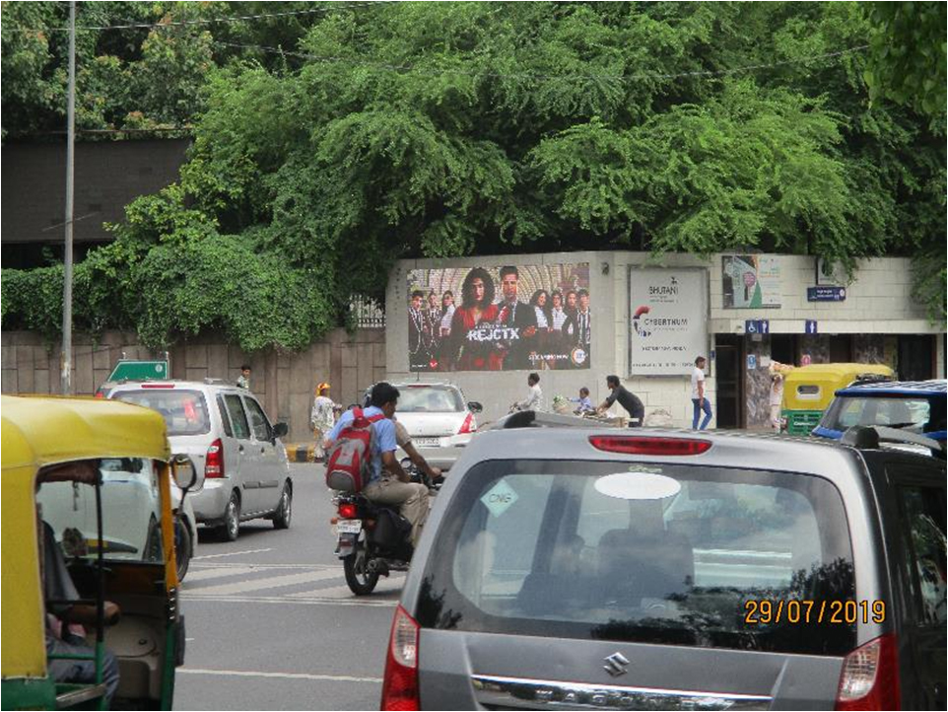
Name : CP Outer Circle (Shivaji Stadium Turning)
Media Type : Hoarding LED
City : Delhi
Location : CP Outer Circle (Shivaji Stadium Turning)
GEO Location :
Size :
Illumination : Ledscreen
Price : 440000
Foot fall : 0

Slide 4


