Slide 1


Slide 2
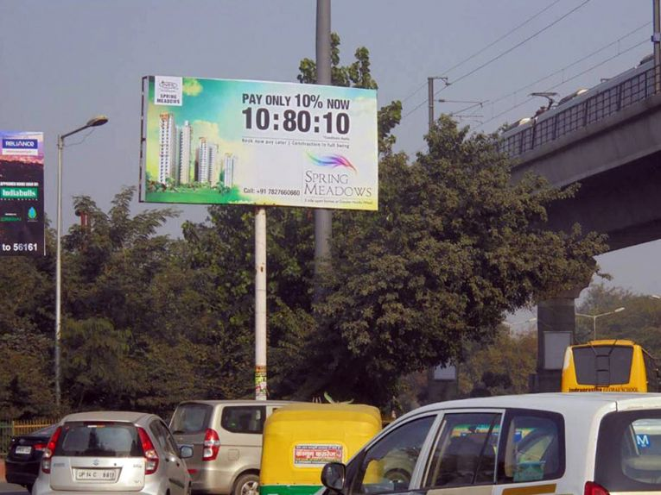
Name : Golf Course (Noida), Noida
Media Type : Unipole
City : Noida
Location : Unnamed Road, Sector 39
GEO Location : 28.573242 , 77.354566
Size : 200 Sq. Ft
Illumination : Nonlit
Price : 150000
Foot fall : 0

Slide 3


