Slide 1


Slide 2
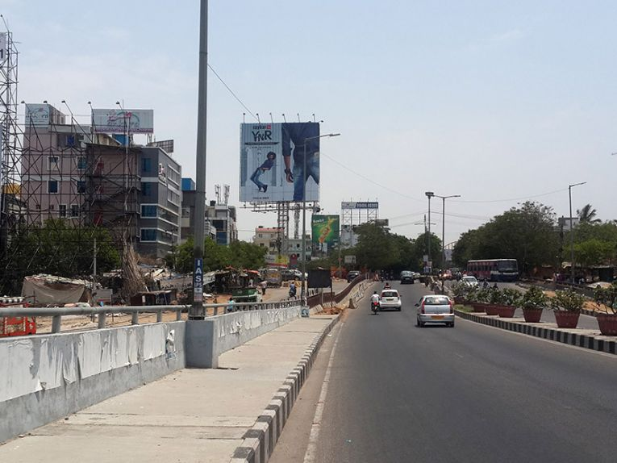

CAMPAIGN DETAILS OF
Site name : Hitech city, Hyderabad
Media Type : Unipole
SITE
Name : Hitech city, Hyderabad
Media Type : Unipole
City : Hyderabad
Location : K P H B Phase 4, Kukatpally
GEO Location : 17.472886 , 78.387401
Size : 1600 Sq. Ft
Illumination : Frontlit
Price : 330000
Foot fall : 0

Slide 3


