Slide 1


Slide 2
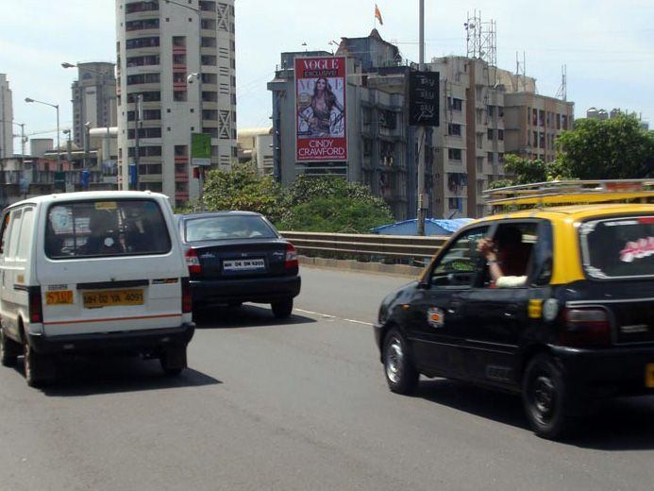

CAMPAIGN DETAILS OF
Site name : Dadar, Mumbai
Media Type : Billboard
SITE
Name : Dadar, Mumbai
Media Type : Billboard
City : Mumbai
Location : Dighe Nagar, Parel
GEO Location : 19.007517 , 72.835615
Size : 450 Sq. Ft
Illumination : Frontlit
Price : 192500
Foot fall : 0

Slide 3


