Slide 1


Slide 2
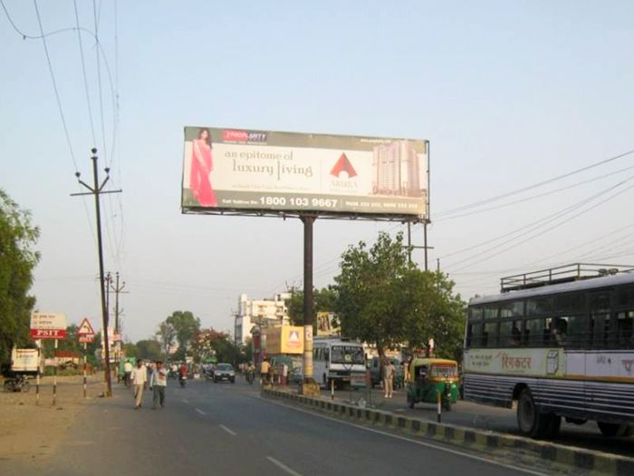

CAMPAIGN DETAILS OF
Site name : Ramdevi, Kanpur
Media Type : Unipole
SITE
Name : Ramdevi, Kanpur
Media Type : Unipole
City : Kanpur
Location : Shiv Katra, Krishna Nagar
GEO Location : 26.415256 , 80.382684
Size : 300 Sq. Ft
Illumination : Nonlit
Price : 16500
Foot fall : 0

Slide 3


