Slide 1


Slide 2
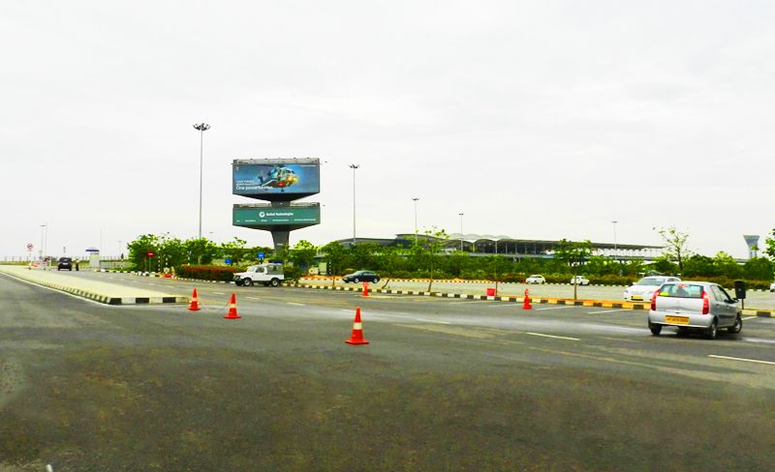

CAMPAIGN DETAILS OF
Site name : Unipole
Media Type : Unipole
SITE
Name : Unipole
Media Type : Unipole
City : Hyderabad
Location : City to Airport Road
GEO Location : ,
Size :
Illumination : Various
Price : 1100000
Foot fall : 0

Slide 3


