Slide 1


Slide 2
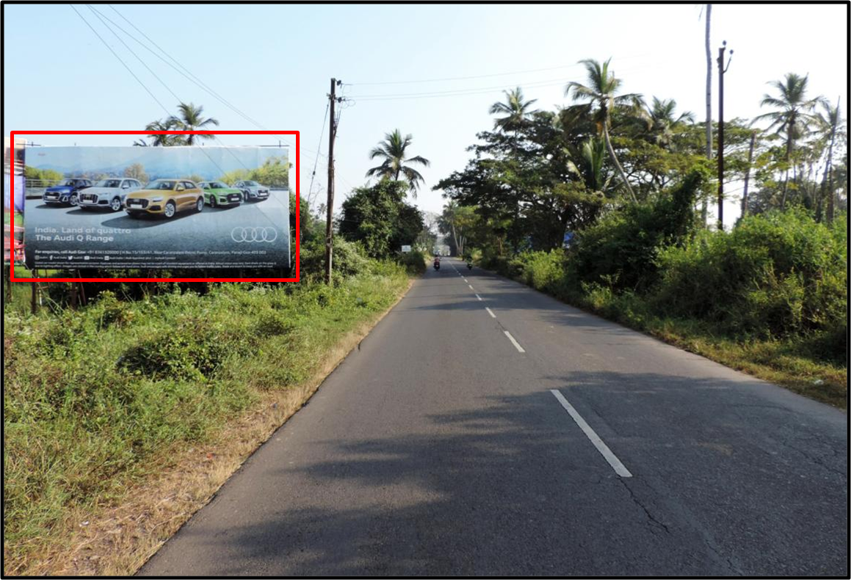

CAMPAIGN DETAILS OF
Site name : Margao Entrance
Media Type : Billboard
SITE
Name : Margao Entrance
Media Type : Billboard
City : Margao
Location : Margao Entrance
GEO Location : null
Size : 820
Illumination : Nonlit
Price : 80000
Foot fall : 0

Slide 3
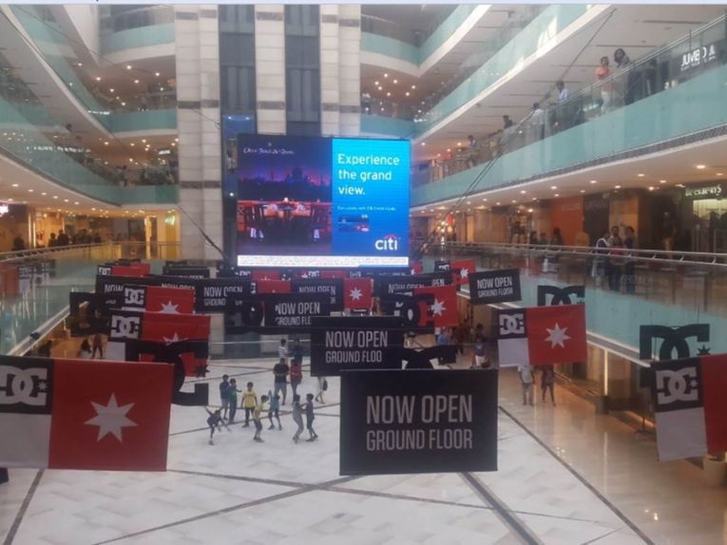
CAMPAIGN DETAILS OF
Site name : Ambience Mall
Media Type : Digital Signage
SITE
Name : Ambience Mall
Media Type : Digital Signage
City : Gurgaon
Location : In second atrium
GEO Location : 28.504151 , 77.097055
Size : 140 Sq. ft.
Illumination :
Price : 385000
Foot fall : 0

Slide 4


