Slide 1


Slide 2
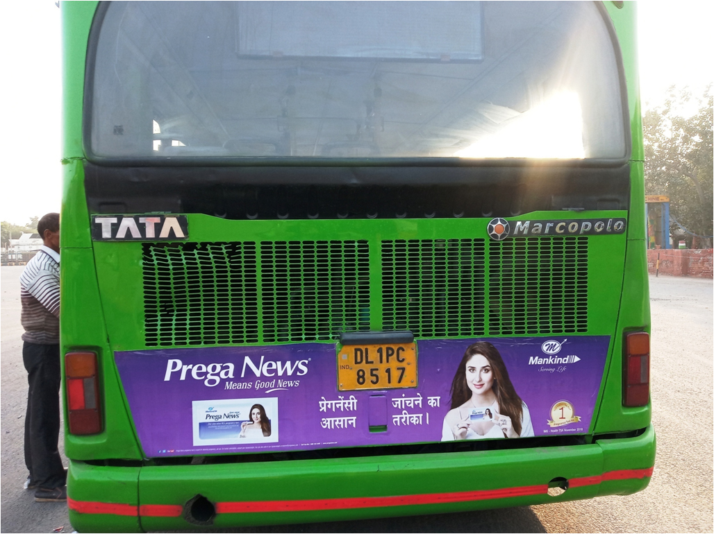

CAMPAIGN DETAILS OF
Site name : DTC Bus
Media Type : Bus Branding
SITE
Name : DTC Bus
Media Type : Bus Branding
City : Delhi
Location : Delhi
GEO Location :
Size :
Illumination :
Price : 27500
Foot fall : 1

Slide 3
