Slide 1


Slide 2
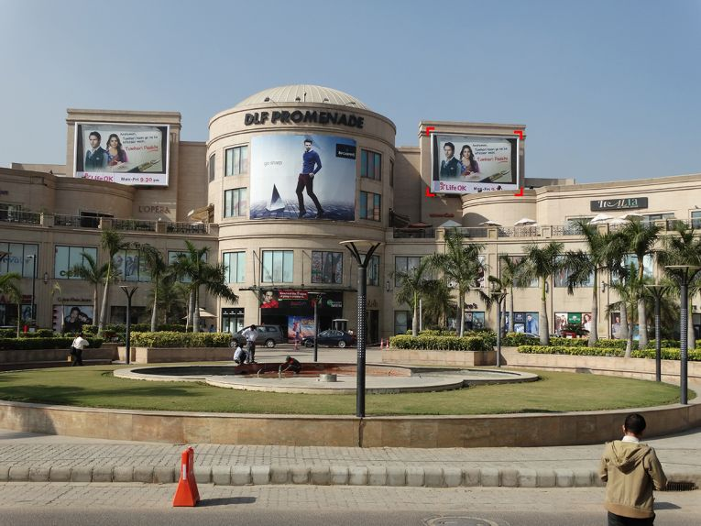

CAMPAIGN DETAILS OF
Site name : DLF Promenade
Media Type : Facade
SITE
Name : DLF Promenade
Media Type : Facade
City : Delhi
Location : Facing Nelson Mandela Road
GEO Location : 28.542582 , 77.156283
Size : 600 Sq. ft.
Illumination :
Price : 495000
Foot fall : 0

Slide 3
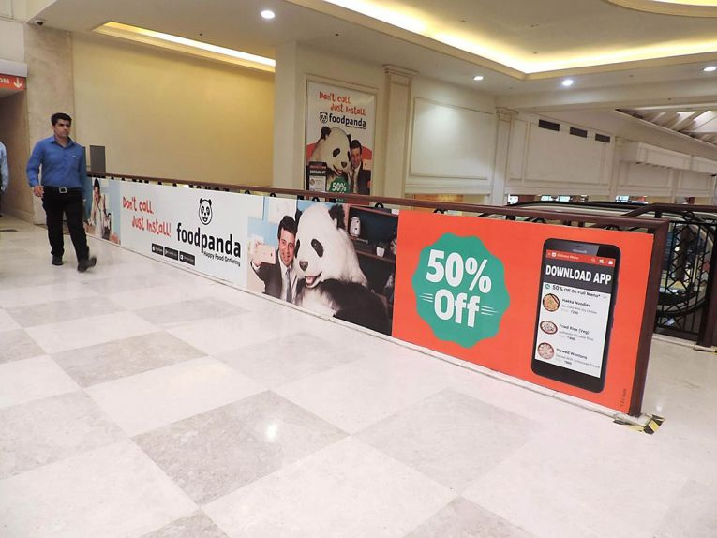
CAMPAIGN DETAILS OF
Site name : DLF Promenade
Media Type : Food Court Signage
SITE
Name : DLF Promenade
Media Type : Food Court Signage
City : Delhi
Location : Food Court
GEO Location : 28.542693 , 77.155550
Size : 84 Sq. ft.
Illumination :
Price : 55000
Foot fall : 0

Slide 4


