Slide 1


Slide 2
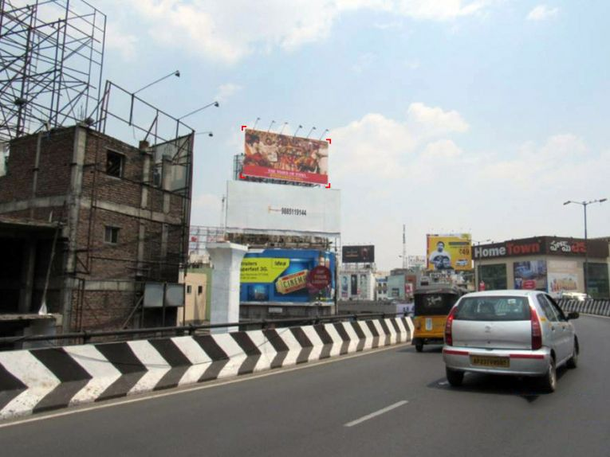

CAMPAIGN DETAILS OF
Site name : Punjagutta, Hyderabad
Media Type : Billboard
SITE
Name : Punjagutta, Hyderabad
Media Type : Billboard
City : Hyderabad
Location : Durga Nagar, Somajiguda
GEO Location : 17.427099 , 78.452831
Size : 1250 Sq. Ft
Illumination : Frontlit
Price : 137500
Foot fall : 0

Slide 3
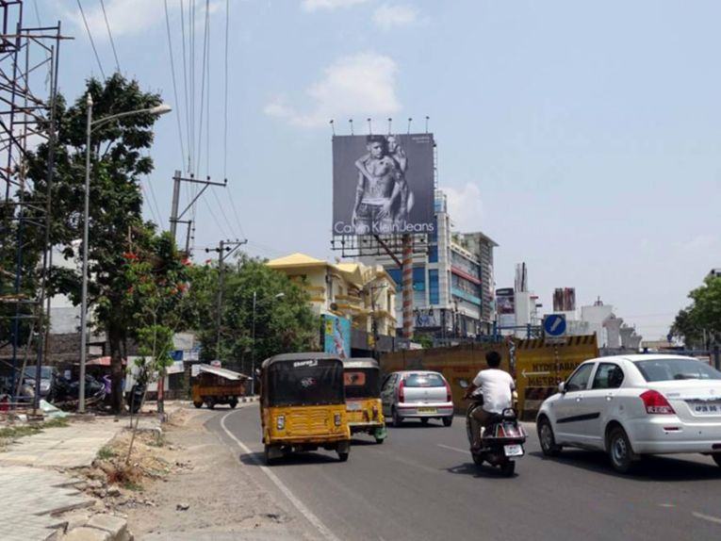
CAMPAIGN DETAILS OF
Site name : Jubilee Hills, Hyderabad
Media Type : Unipole
SITE
Name : Jubilee Hills, Hyderabad
Media Type : Unipole
City : Hyderabad
Location : Jawahar Colony, Jubilee Hills
GEO Location : 17.428956 , 78.413188
Size : 1600 Sq. Ft
Illumination : Frontlit
Price : 357500
Foot fall : 0

Slide 4
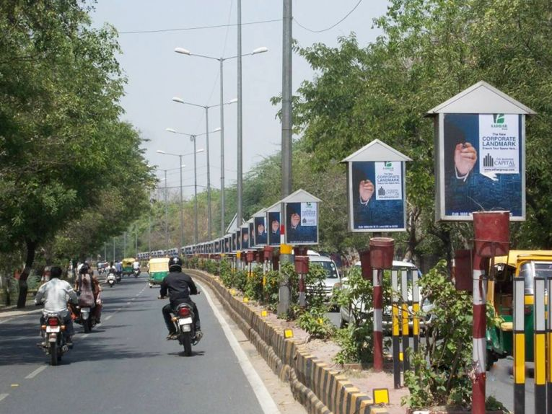
CAMPAIGN DETAILS OF
Site name : MG Road, Agra
Media Type : Pole Kiosks
SITE
Name : MG Road, Agra
Media Type : Pole Kiosks
City : Agra
Location : Panchkuian, Rakabganj
GEO Location : 27.180235 , 78.002713
Size : 4 Sq. Ft
Illumination : Nonlit
Price : 16500
Foot fall : 0

Slide 5


