Slide 1


Slide 2
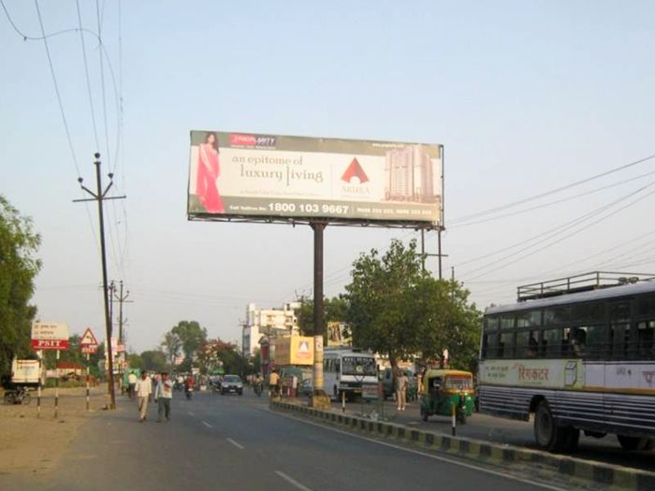

CAMPAIGN DETAILS OF
Site name : Ramdevi, Kanpur
Media Type : Unipole
SITE
Name : Ramdevi, Kanpur
Media Type : Unipole
City : Kanpur
Location : Shiv Katra, Krishna Nagar
GEO Location : 26.415256 , 80.382684
Size : 300 Sq. Ft
Illumination : Nonlit
Price : 16500
Foot fall : 0

Slide 3
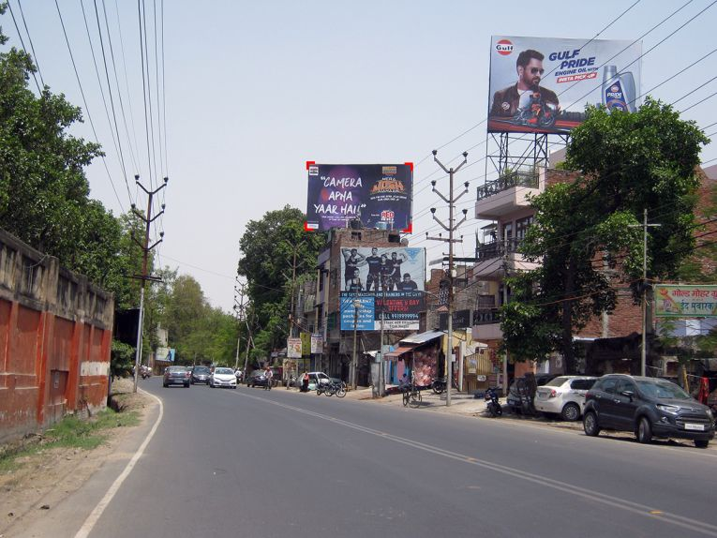
CAMPAIGN DETAILS OF
Site name : V.I.P. Road, Kanpur sdfsdf
Media Type : Billboard
SITE
Name : V.I.P. Road, Kanpur sdfsdf
Media Type : Billboard
City : Kanpur
Location : Chandra Shekhar Azad University of Agriculture and, Nawabganj
GEO Location : 26.488411 , 80.308720
Size : 600 Sq. Ft
Illumination : Nonlit
Price : 39600
Foot fall : 0

Slide 4


