Slide 1


Slide 2
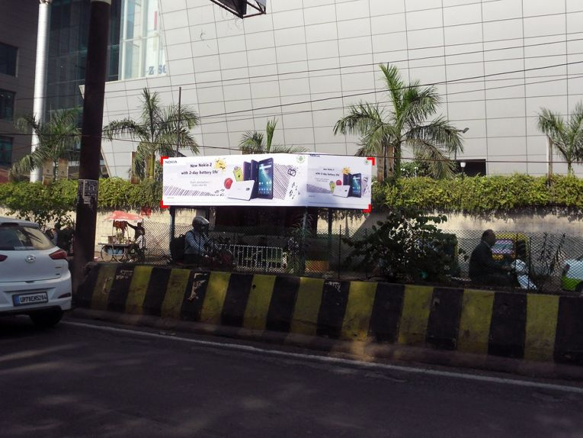

CAMPAIGN DETAILS OF
Site name : Bada Chauraha, Kanpur
Media Type : Bus Shelter
SITE
Name : Bada Chauraha, Kanpur
Media Type : Bus Shelter
City : Kanpur
Location : near Bada Chauraha, Civil Lines
GEO Location : 26.472796 , 80.352813
Size : 228 Sq. Ft
Illumination : Nonlit
Price : 16500
Foot fall : 0

Slide 3
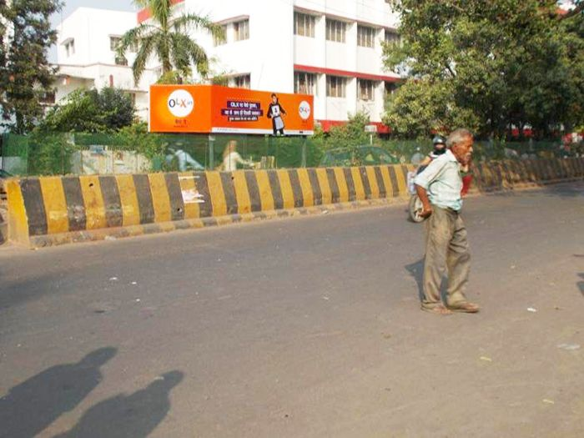
CAMPAIGN DETAILS OF
Site name : Bada Chauraha, Kanpur
Media Type : Bus Shelter
SITE
Name : Bada Chauraha, Kanpur
Media Type : Bus Shelter
City : Kanpur
Location : Shiwala, Patkapur
GEO Location : 26.473277 , 80.351128
Size : 228 Sq. Ft
Illumination : Nonlit
Price : 16500
Foot fall : 0

Slide 4


