Slide 1


Slide 2
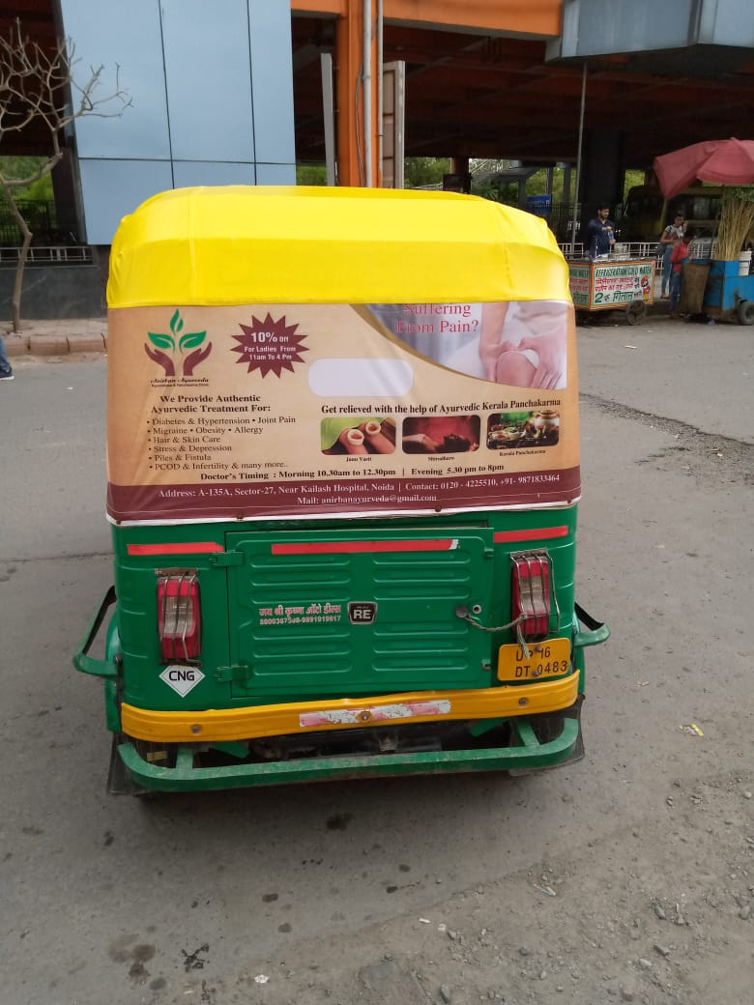

CAMPAIGN DETAILS OF
Site name : Auto Flex Hood
Media Type : Auto Advertising
SITE
Name : Auto Flex Hood
Media Type : Auto Advertising
City : Noida
Location : Noida
GEO Location :
Size :
Illumination :
Price : 605
Foot fall : 1

Slide 3


