Slide 1


Slide 2
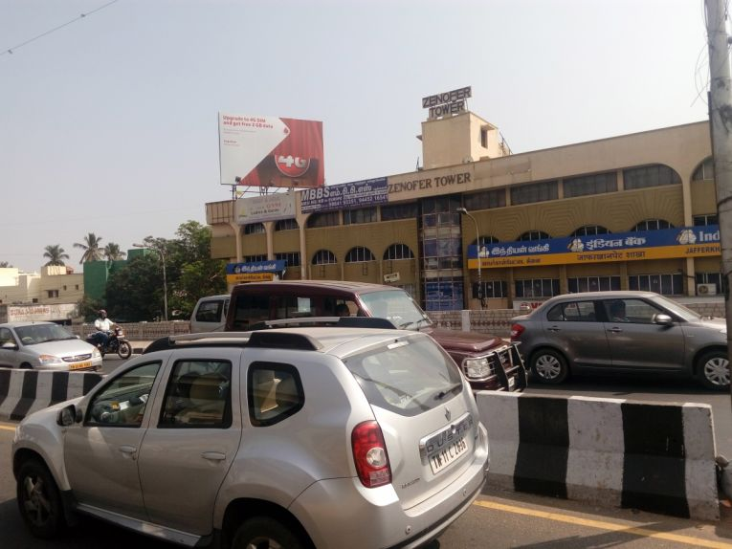

CAMPAIGN DETAILS OF
Site name : Nungambakkam, Chennai
Media Type : Billboard
SITE
Name : Nungambakkam, Chennai
Media Type : Billboard
City : Chennai
Location : Tirumurthy Nagar, Nungambakkam
GEO Location : 13.063790 , 80.243561
Size : 600 Sq. Ft
Illumination : Frontlit
Price : 330000
Foot fall : 0

Slide 3


