Slide 1


Slide 2
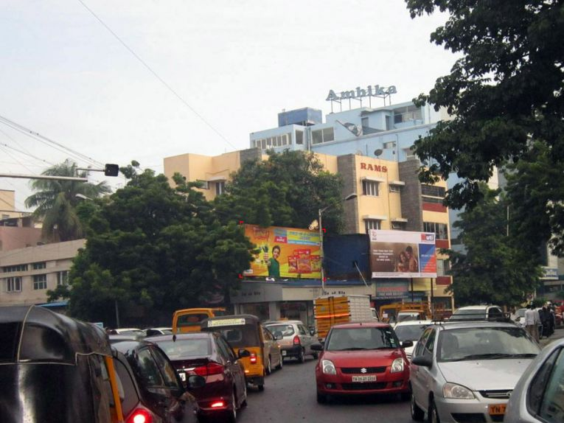

CAMPAIGN DETAILS OF
Site name : T Nagar, Chennai
Media Type : Billboard
SITE
Name : T Nagar, Chennai
Media Type : Billboard
City : Chennai
Location : Parthasarathi Puram, T. Nagar
GEO Location : 13.040304 , 80.233751
Size : 200 Sq. Ft
Illumination : Frontlit
Price : 49500
Foot fall : 0

Slide 3


