Slide 1


Slide 2
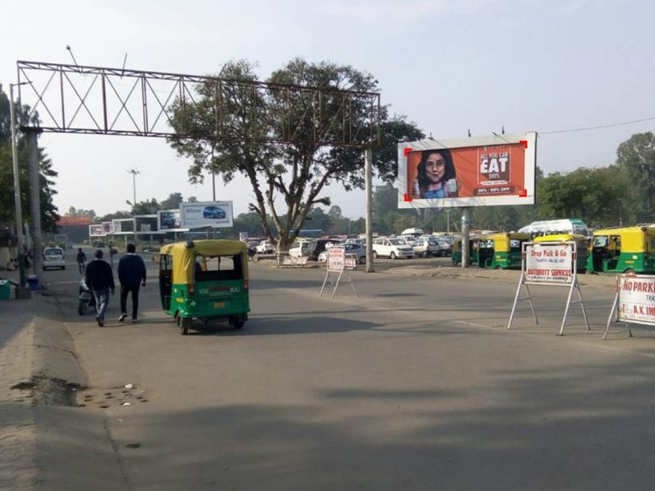

CAMPAIGN DETAILS OF
Site name : Railway Station, Chandigarh
Media Type : Unipole
SITE
Name : Railway Station, Chandigarh
Media Type : Unipole
City : Chandigarh
Location : Chandigarh, Daria
GEO Location : 30.701959 , 76.820632
Size : 144 Sq. Ft
Illumination : Nonlit
Price : 192500
Foot fall : 0

Slide 3


