Slide 1


Slide 2
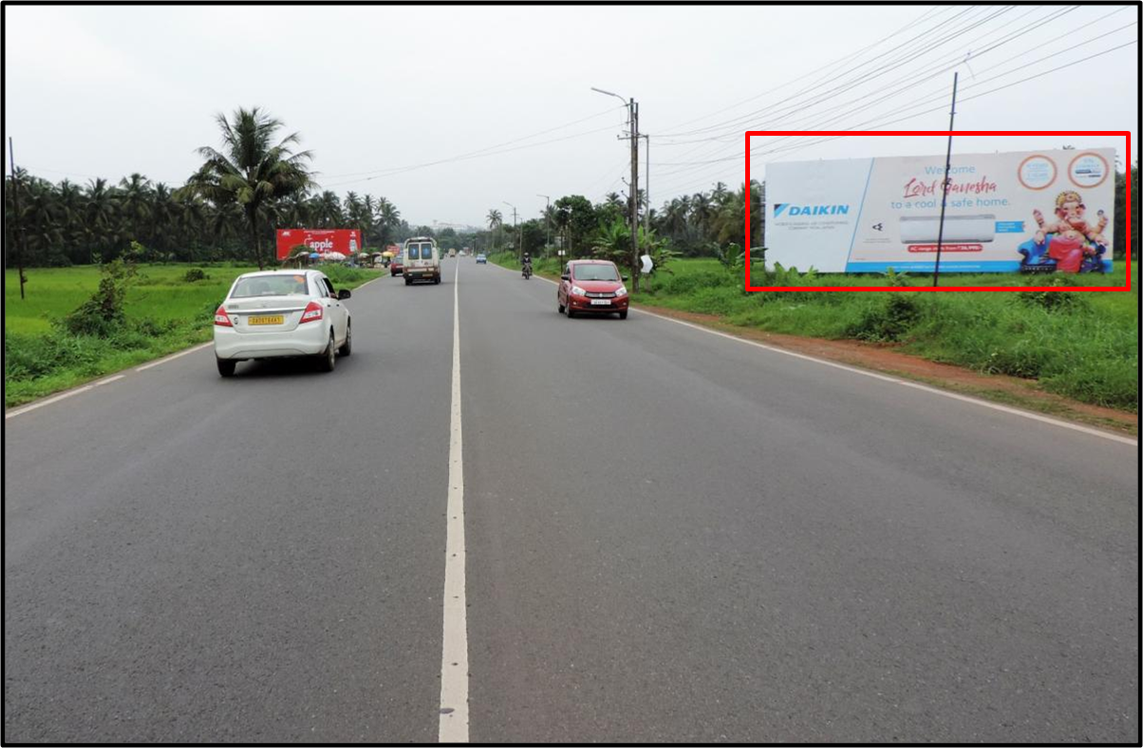

CAMPAIGN DETAILS OF
Site name : Verna ftf Margao to Panjim/Airport
Media Type : Billboard
SITE
Name : Verna ftf Margao to Panjim/Airport
Media Type : Billboard
City : Panjim
Location : Verna ftf Margao to Panjim/Airport
GEO Location : null
Size : 6724
Illumination : Nonlit
Price : 123000
Foot fall : 0

Slide 3
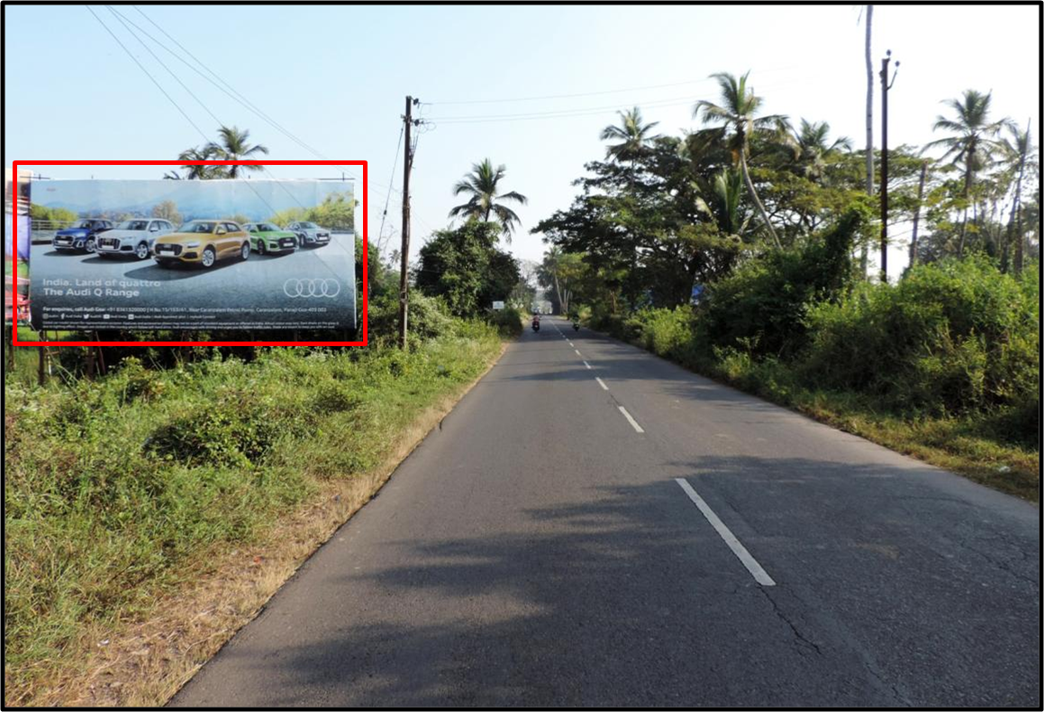
CAMPAIGN DETAILS OF
Site name : Margao Entrance
Media Type : Billboard
SITE
Name : Margao Entrance
Media Type : Billboard
City : Margao
Location : Margao Entrance
GEO Location : null
Size : 820
Illumination : Nonlit
Price : 80000
Foot fall : 0

Slide 4


