Slide 1


Slide 2
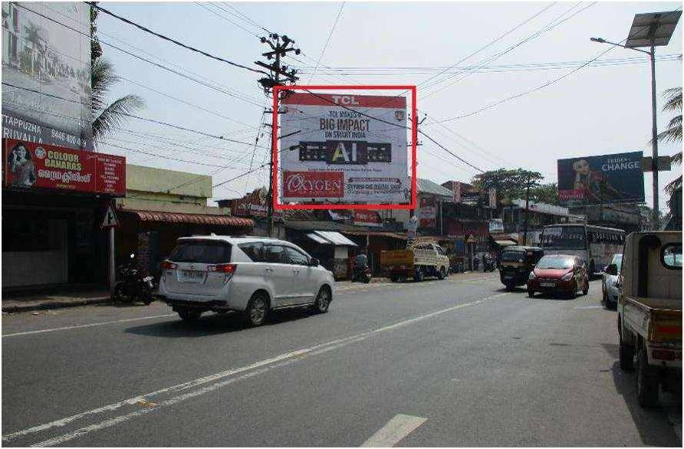

CAMPAIGN DETAILS OF
Site name : Changanassery Perunna - KOTTAYAM
Media Type : Billboard
SITE
Name : Changanassery Perunna - KOTTAYAM
Media Type : Billboard
City : Kottayam
Location : Changanassery Perunna - KOTTAYAM
GEO Location : null
Size : 750
Illumination : Nonlit
Price : 22500
Foot fall : 0

Slide 3


