Slide 1


Slide 2
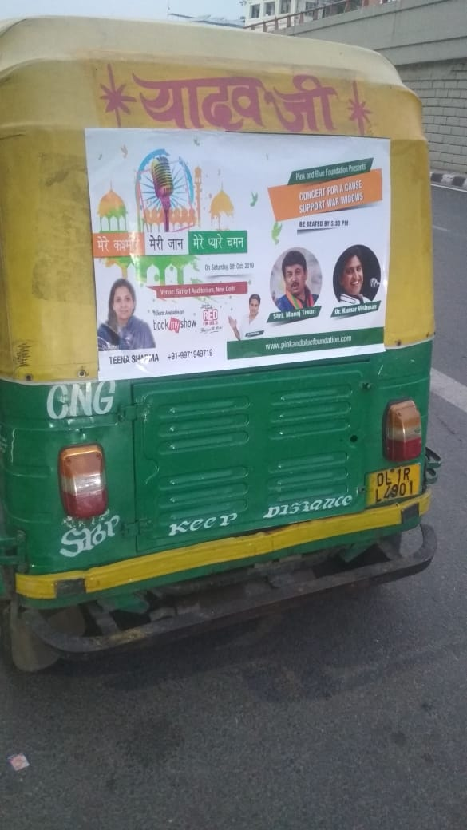

CAMPAIGN DETAILS OF
Site name : Auto Vinyl
Media Type : Auto Advertising
SITE
Name : Auto Vinyl
Media Type : Auto Advertising
City : Delhi
Location : Delhi
GEO Location :
Size :
Illumination :
Price : 220
Foot fall : 1

Slide 3


