Slide 1


Slide 2
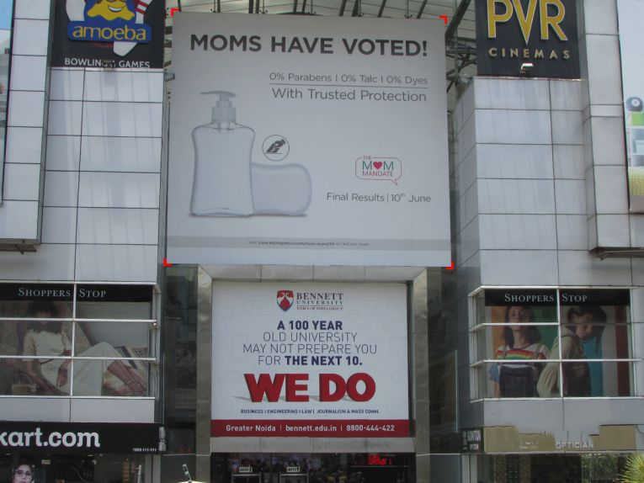

CAMPAIGN DETAILS OF
Site name : MGF Metropolitan
Media Type : Glass Facade
SITE
Name : MGF Metropolitan
Media Type : Glass Facade
City : Gurgaon
Location : At the mall entry facing MG Road.
GEO Location : 28.480248 , 77.080218
Size : 728 Sq. ft.
Illumination :
Price : 632500
Foot fall : 0

Slide 3


