Slide 1


Slide 2
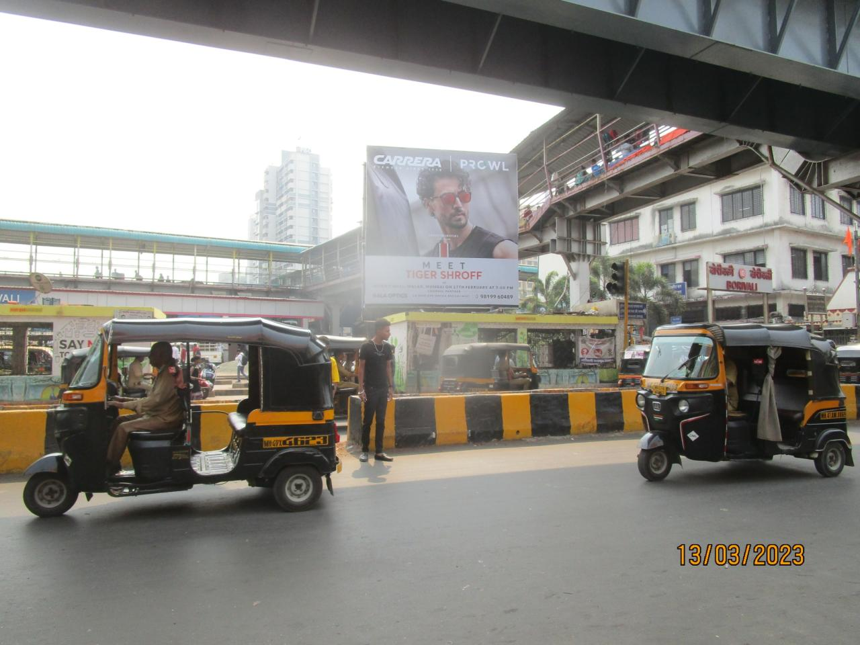

CAMPAIGN DETAILS OF
Site name : Borivali opp Goyal shopping center fcg SV Road LT Road Junction
Media Type : Hoarding
SITE
Name : Borivali opp Goyal shopping center fcg SV Road LT Road Junction
Media Type : Hoarding
City : Mumbai
Location : Borivali opp Goyal shopping center fcg SV Road LT Road Junction
GEO Location : null
Size : 420
Illumination : Nonlit
Price : 650000
Foot fall : 0

Slide 3
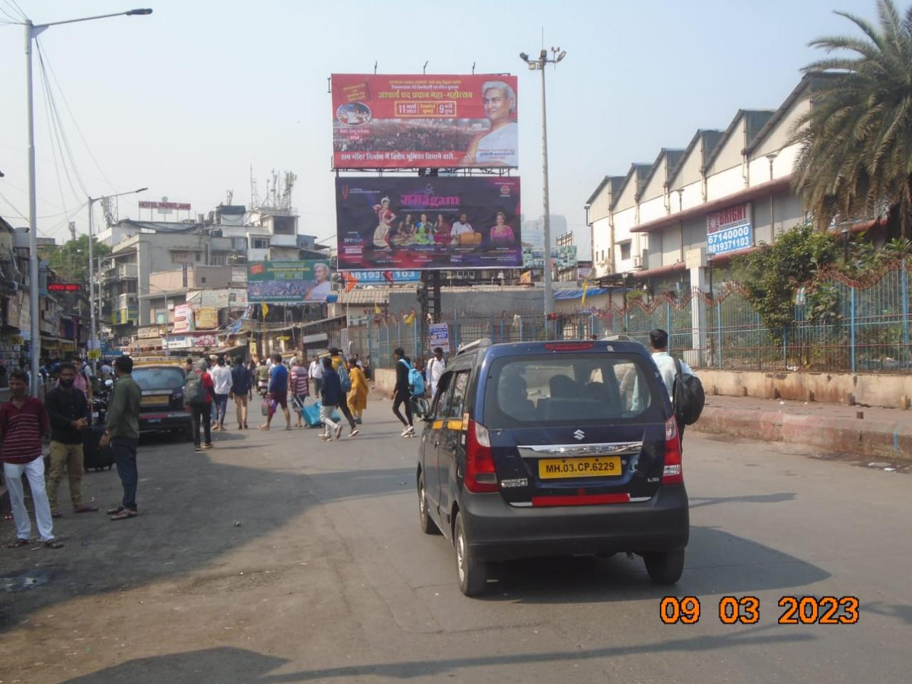
CAMPAIGN DETAILS OF
Site name : Dadar East nr Taxi Stand opp Swami Narayan Temple Lower
Media Type : Hoarding
SITE
Name : Dadar East nr Taxi Stand opp Swami Narayan Temple Lower
Media Type : Hoarding
City : Mumbai
Location : Dadar East nr Taxi Stand opp Swami Narayan Temple Lower
GEO Location : null
Size : 450
Illumination : Nonlit
Price : 1050000
Foot fall : 0

Slide 4


