Slide 1


Slide 2
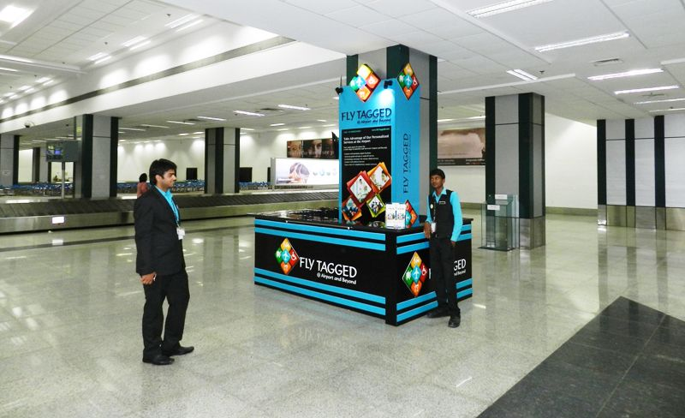

CAMPAIGN DETAILS OF
Site name : BTL Activation
Media Type : BTL Activation
SITE
Name : BTL Activation
Media Type : BTL Activation
City : Ahmedabad
Location : Baggage Claim Area
GEO Location : 13.200620 , 77.709426
Size :
Illumination : Various
Price : 1100000
Foot fall : 0

Slide 3
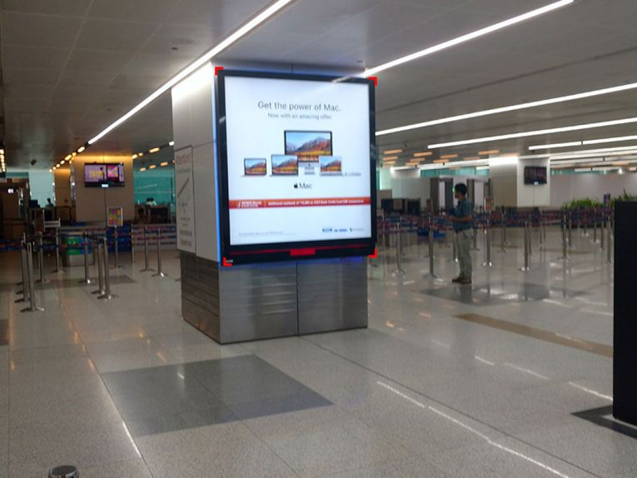
CAMPAIGN DETAILS OF
Site name : Wall Mounted Panels
Media Type : Wall Mounted Panels
SITE
Name : Wall Mounted Panels
Media Type : Wall Mounted Panels
City : New Delhi
Location : Security Check Area
GEO Location : 28.553634 , 77.083436
Size :
Illumination : Various
Price : 1100000
Foot fall : 0

Slide 4


