Slide 1


Slide 2
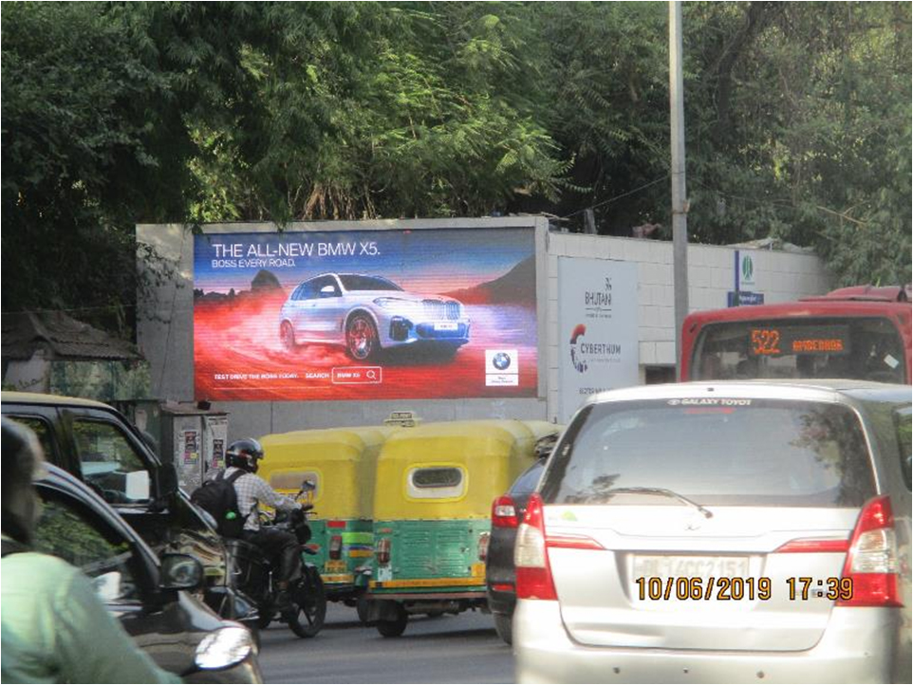

CAMPAIGN DETAILS OF
Site name : CP Outer Circle (Chemsford Turning)
Media Type : Hoarding LED
SITE
Name : CP Outer Circle (Chemsford Turning)
Media Type : Hoarding LED
City : Delhi
Location : CP Outer Circle (Chemsford Turning)
GEO Location :
Size :
Illumination : Ledscreen
Price : 440000
Foot fall : 0

Slide 3


