Slide 1


Slide 2
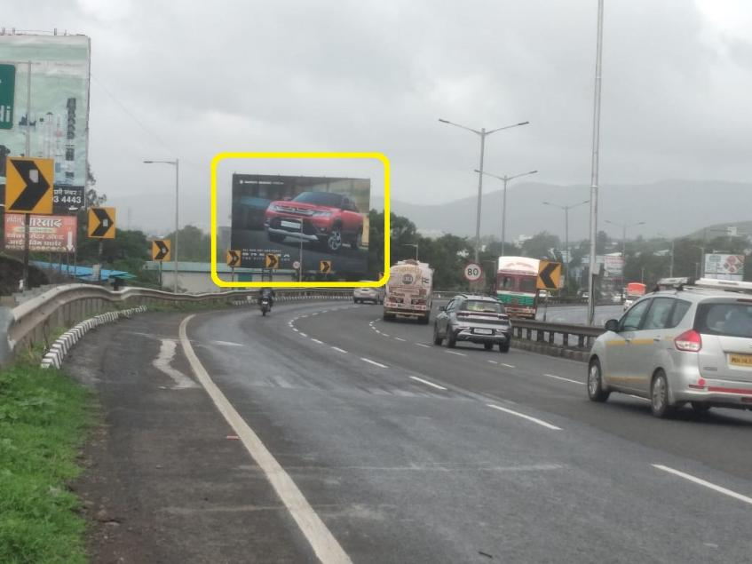

CAMPAIGN DETAILS OF
Site name : PUNE SATARA HIGHWAY, Sasewadi, FTF Pune to Khedshivapur
Media Type : Hoarding
SITE
Name : PUNE SATARA HIGHWAY, Sasewadi, FTF Pune to Khedshivapur
Media Type : Hoarding
City : Pune
Location : PUNE SATARA HIGHWAY, Sasewadi, FTF Pune to Khedshivapur
GEO Location : null
Size : 2400
Illumination : Nonlit
Price : 125000
Foot fall : 0

Slide 3


