Slide 1


Slide 2
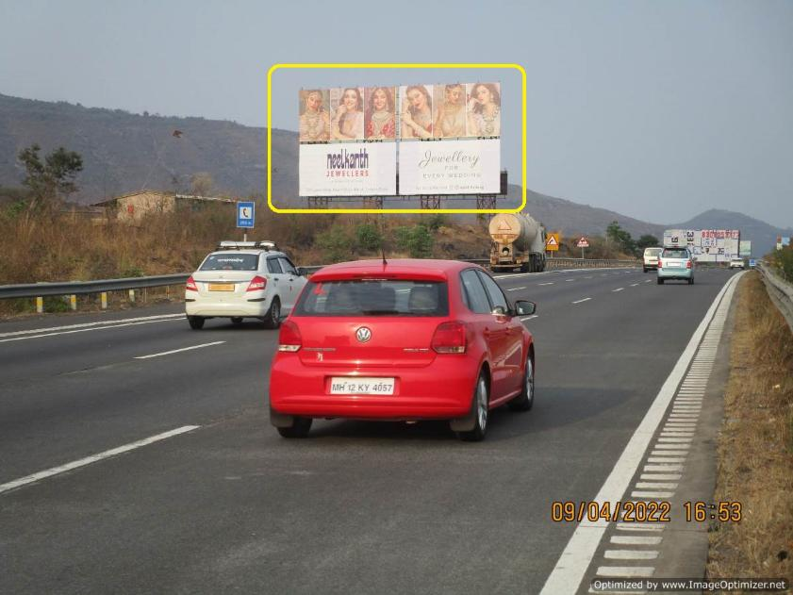

CAMPAIGN DETAILS OF
Site name : XPSWAY, Urse, Hinoday Flyover, FTF Pune to Mumbai
Media Type : Hoarding
SITE
Name : XPSWAY, Urse, Hinoday Flyover, FTF Pune to Mumbai
Media Type : Hoarding
City : Pune
Location : XPSWAY, Urse, Hinoday Flyover, FTF Pune to Mumbai
GEO Location : null
Size : 3000
Illumination : Nonlit
Price : 50000
Foot fall : 0

Slide 3
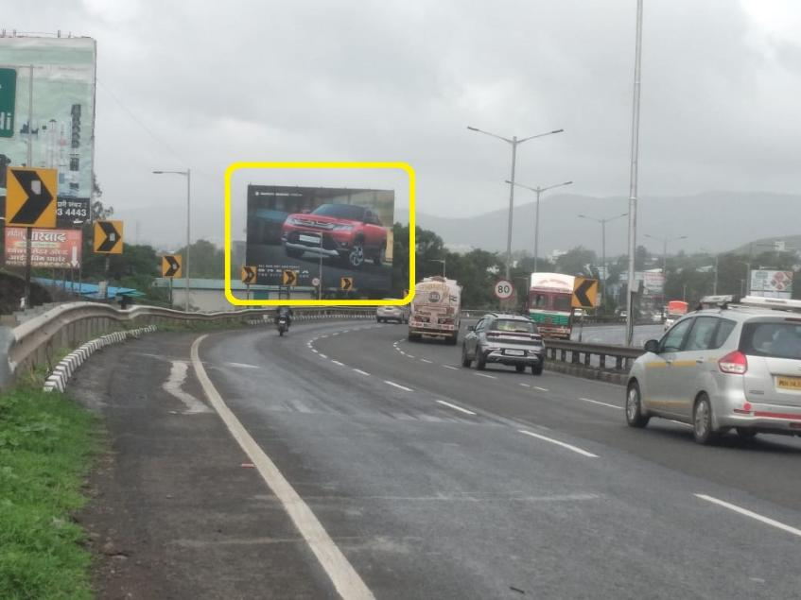
CAMPAIGN DETAILS OF
Site name : PUNE SATARA HIGHWAY, Sasewadi, FTF Pune to Khedshivapur
Media Type : Hoarding
SITE
Name : PUNE SATARA HIGHWAY, Sasewadi, FTF Pune to Khedshivapur
Media Type : Hoarding
City : Pune
Location : PUNE SATARA HIGHWAY, Sasewadi, FTF Pune to Khedshivapur
GEO Location : null
Size : 2400
Illumination : Nonlit
Price : 125000
Foot fall : 0

Slide 4
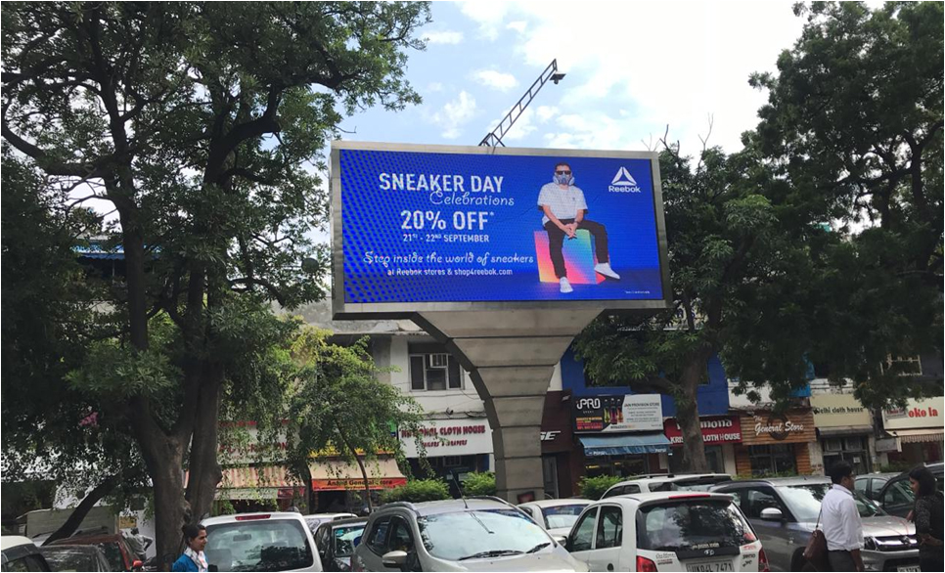
CAMPAIGN DETAILS OF
Site name : Khan Market Parking
Media Type : Hoarding LED
SITE
Name : Khan Market Parking
Media Type : Hoarding LED
City : Delhi
Location : Khan Market Parking
GEO Location :
Size :
Illumination : Ledscreen
Price : 715000
Foot fall : 0

Slide 5


