Slide 1


Slide 2
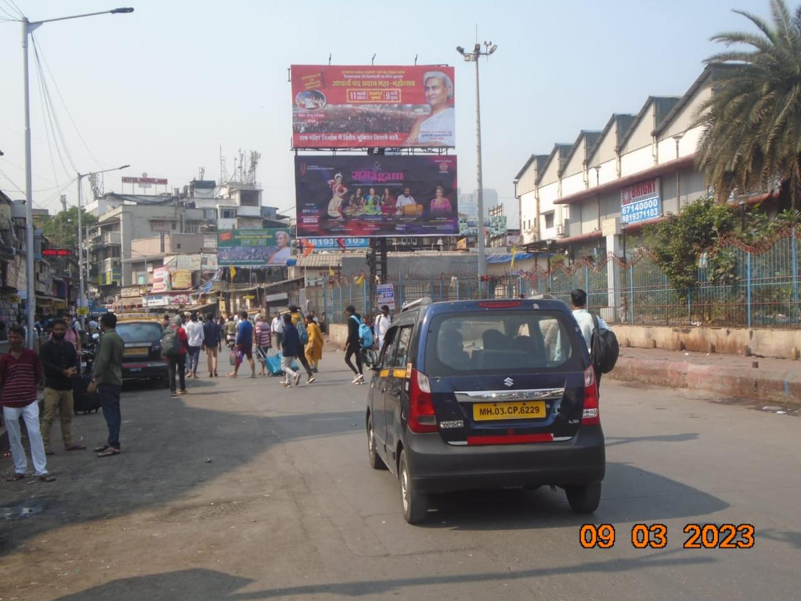

CAMPAIGN DETAILS OF
Site name : Dadar East nr Taxi Stand opp Swami Narayan Temple Lower
Media Type : Hoarding
SITE
Name : Dadar East nr Taxi Stand opp Swami Narayan Temple Lower
Media Type : Hoarding
City : Mumbai
Location : Dadar East nr Taxi Stand opp Swami Narayan Temple Lower
GEO Location : null
Size : 450
Illumination : Nonlit
Price : 1050000
Foot fall : 0

Slide 3
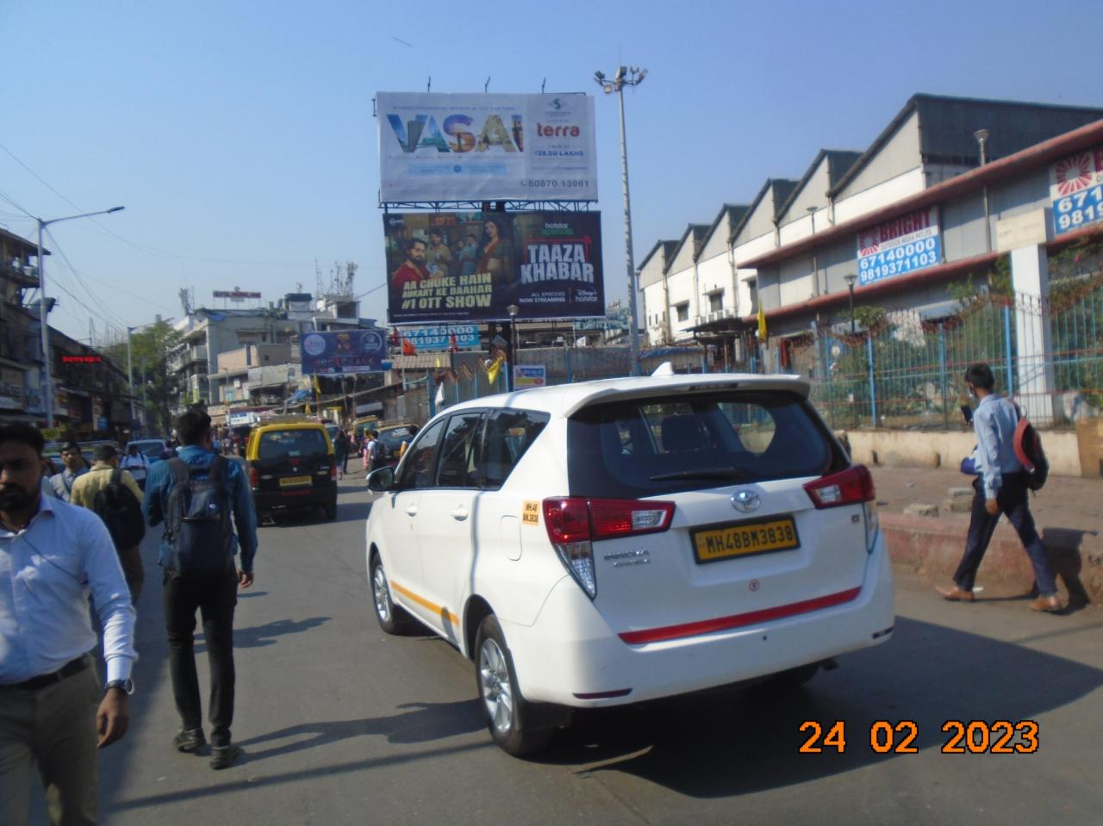
CAMPAIGN DETAILS OF
Site name : Dadar East nr Taxi Stand opp Swami Narayan Temple Upper
Media Type : Hoarding
SITE
Name : Dadar East nr Taxi Stand opp Swami Narayan Temple Upper
Media Type : Hoarding
City : Mumbai
Location : Dadar East nr Taxi Stand opp Swami Narayan Temple Upper
GEO Location : null
Size : 450
Illumination : Nonlit
Price : 550000
Foot fall : 0

Slide 4
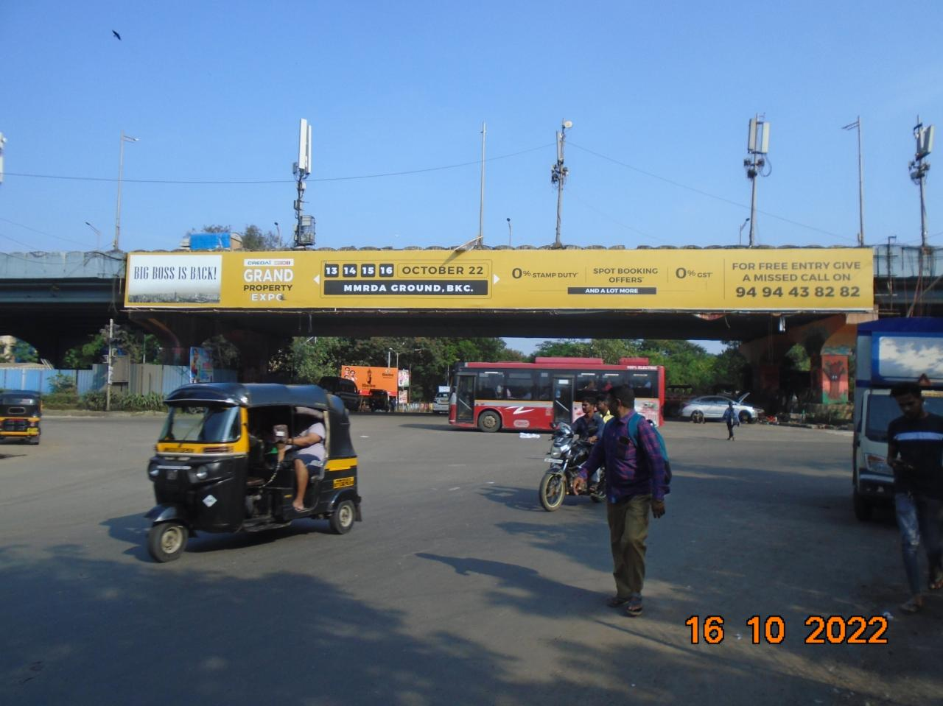
CAMPAIGN DETAILS OF
Site name : GHATKOPAR Station West-Opp Vishwabharti Hotel-1
Media Type : Bridge Panel
SITE
Name : GHATKOPAR Station West-Opp Vishwabharti Hotel-1
Media Type : Bridge Panel
City : Mumbai
Location : GHATKOPAR Station West-Opp Vishwabharti Hotel-1
GEO Location : null
Size : 420
Illumination : Nonlit
Price : 175000
Foot fall : 0

Slide 5


