Slide 1


Slide 2
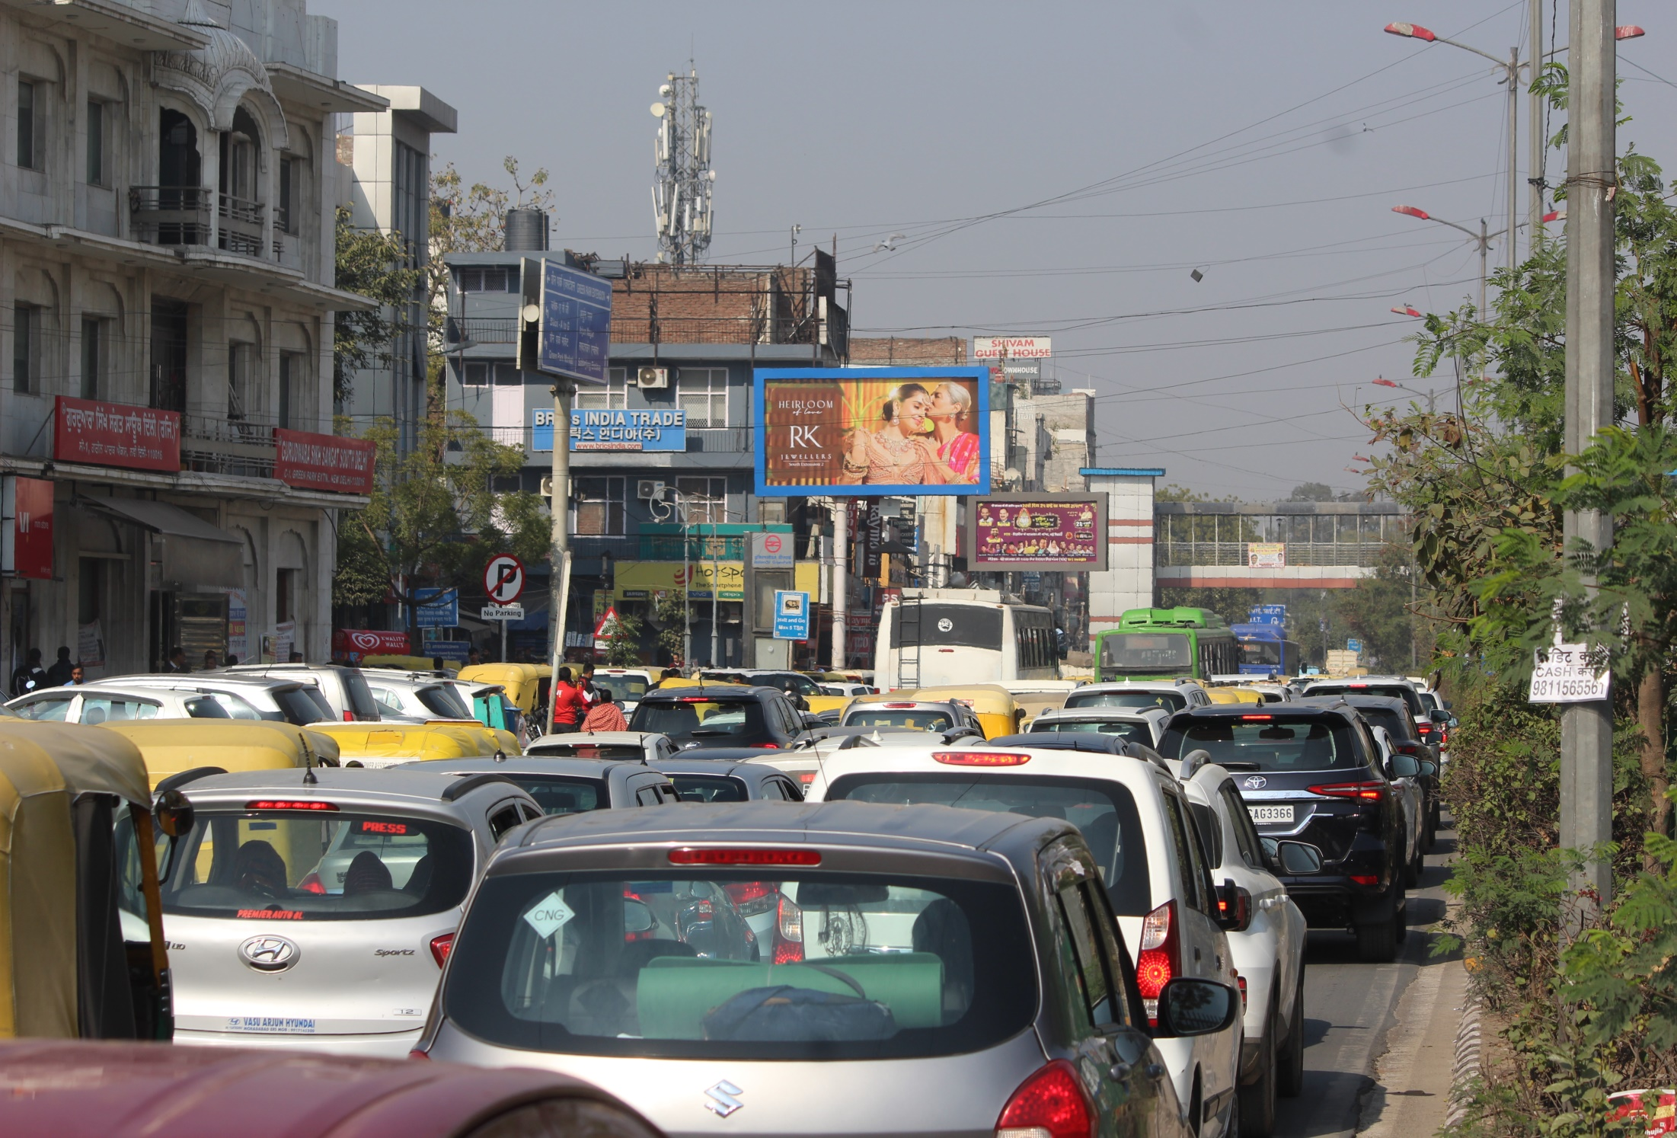

CAMPAIGN DETAILS OF
Site name : Green Park Metro Station Aurobindo Marg towards AIIMS
Media Type : Unipole
SITE
Name : Green Park Metro Station Aurobindo Marg towards AIIMS
Media Type : Unipole
City : Delhi
Location : Green Park Metro Station Aurobindo Marg towards AIIMS
GEO Location : null
Size : 200
Illumination : Backlit
Price : 550000
Foot fall : 0

Slide 3


