Slide 1


Slide 2
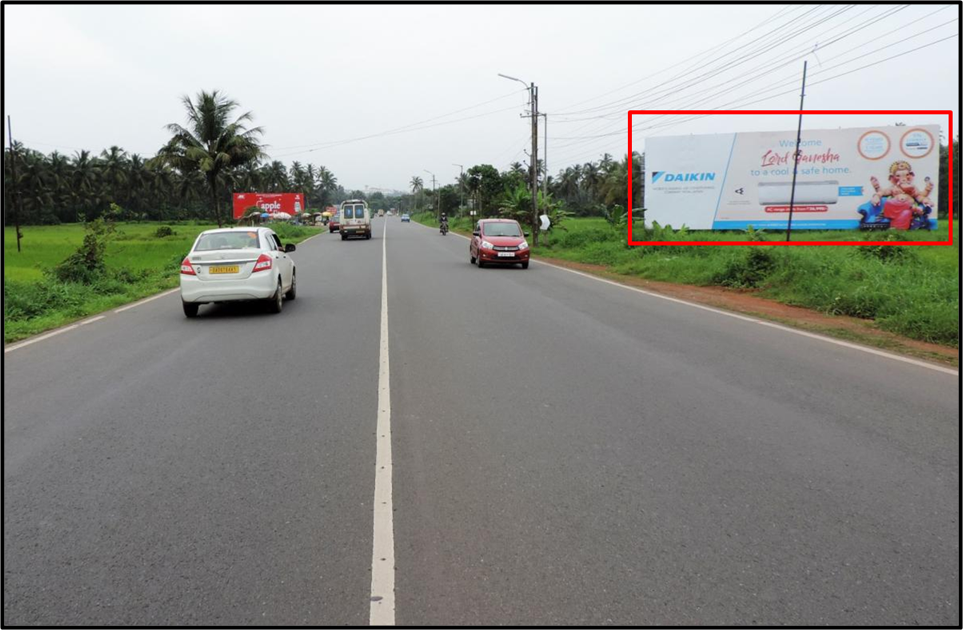

CAMPAIGN DETAILS OF
Site name : Verna ftf Margao to Panjim/Airport
Media Type : Billboard
SITE
Name : Verna ftf Margao to Panjim/Airport
Media Type : Billboard
City : Panjim
Location : Verna ftf Margao to Panjim/Airport
GEO Location : null
Size : 6724
Illumination : Nonlit
Price : 123000
Foot fall : 0

Slide 3
CAMPAIGN DETAILS OF
Site name : Mapusa Market
Media Type : Billboard
SITE
Name : Mapusa Market
Media Type : Billboard
City : Mapusa
Location : Mapusa Market
GEO Location : null
Size : 200
Illumination : Nonlit
Price : 30000
Foot fall : 0

Slide 4


