Slide 1


Slide 2
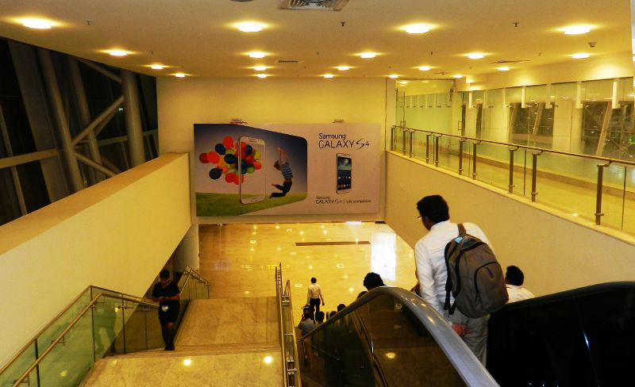

CAMPAIGN DETAILS OF
Site name : Wall Mounted Panels
Media Type : Wall Mounted Panels
SITE
Name : Wall Mounted Panels
Media Type : Wall Mounted Panels
City : Chennai
Location : Welcome Corridor
GEO Location : 12.993838 , 80.171344
Size :
Illumination : Various
Price : 440000
Foot fall : 0

Slide 3


