Slide 1


Slide 2
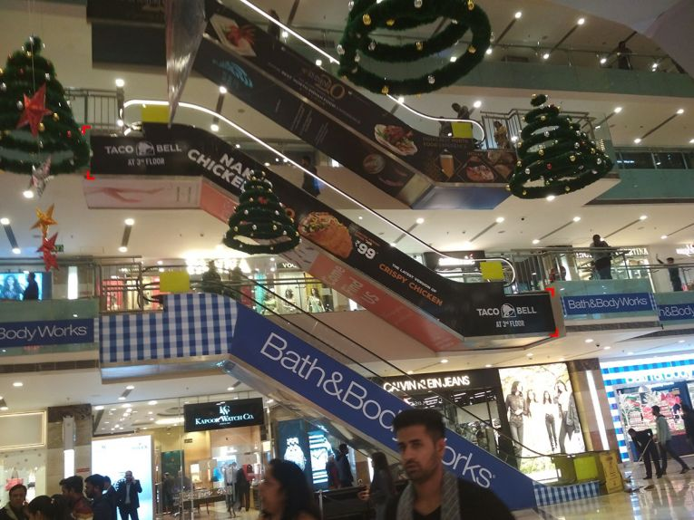

CAMPAIGN DETAILS OF
Site name : Ambience Mall
Media Type : Escalator Wrap
SITE
Name : Ambience Mall
Media Type : Escalator Wrap
City : Gurgaon
Location : In the Central Atrium
GEO Location : 28.504153 , 77.097135
Size : 150 Sq. ft.
Illumination :
Price : 44000
Foot fall : 0

Slide 3
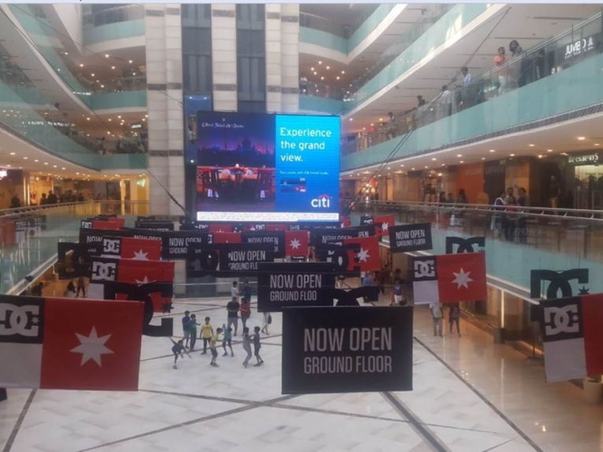
CAMPAIGN DETAILS OF
Site name : Ambience Mall
Media Type : Digital Signage
SITE
Name : Ambience Mall
Media Type : Digital Signage
City : Gurgaon
Location : In second atrium
GEO Location : 28.504151 , 77.097055
Size : 140 Sq. ft.
Illumination :
Price : 385000
Foot fall : 0

Slide 4
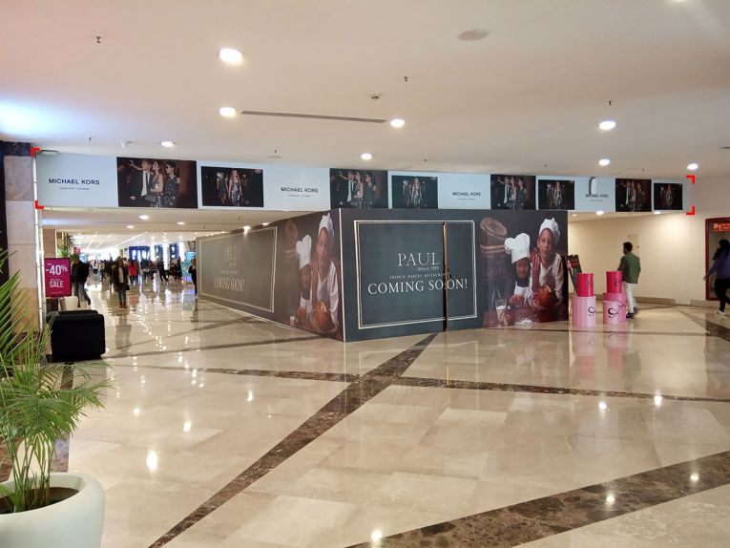
CAMPAIGN DETAILS OF
Site name : Ambience Mall
Media Type : Digital Signage
SITE
Name : Ambience Mall
Media Type : Digital Signage
City : Gurgaon
Location : BMW/Debenhams atrium
GEO Location : 28.505532 , 77.095873
Size : 157.5 Sq. ft.
Illumination :
Price : 275000
Foot fall : 0

Slide 5


