Slide 1


Slide 2
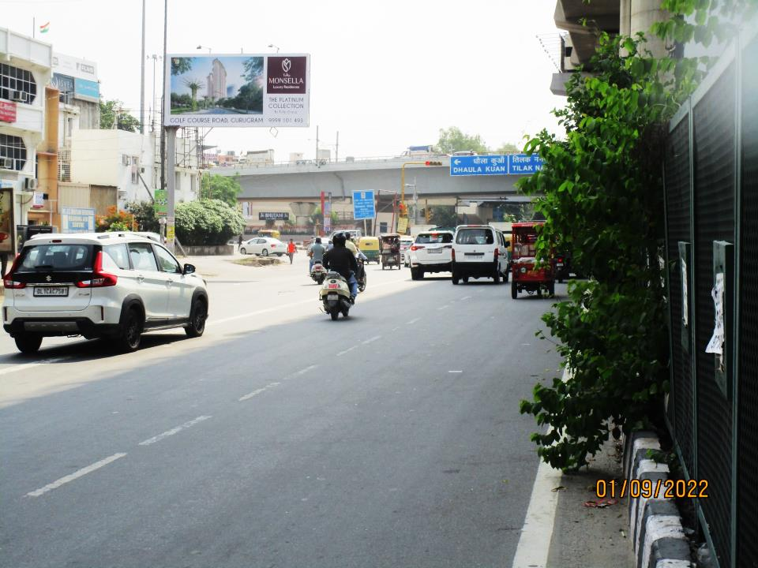

CAMPAIGN DETAILS OF
Site name : Near Raja Garden Red Light towards Ring Road
Media Type : Unipole
SITE
Name : Near Raja Garden Red Light towards Ring Road
Media Type : Unipole
City : Delhi
Location : Near Raja Garden Red Light towards Ring Road
GEO Location : null
Size : 200
Illumination : Frontlit
Price : 150000
Foot fall : 0

Slide 3


