Slide 1


Slide 2
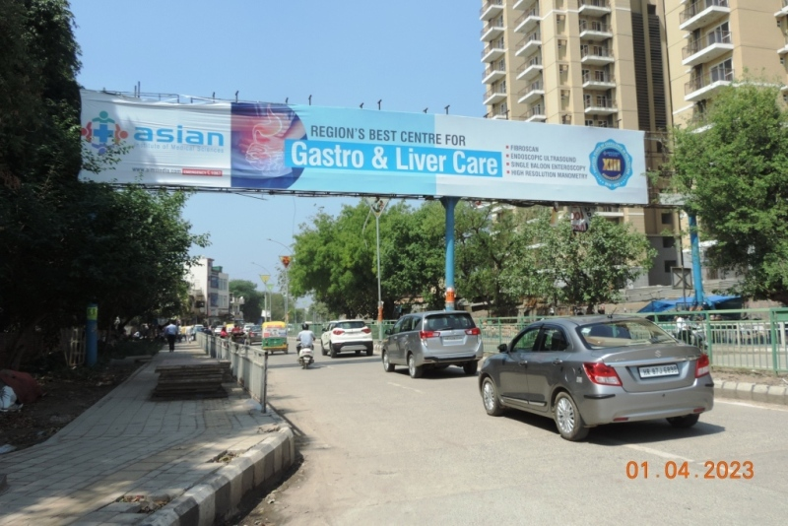

CAMPAIGN DETAILS OF
Site name : Saini Rd, Daulatabad Village, Sector 16A, Faridabad
Media Type : Gentry
SITE
Name : Saini Rd, Daulatabad Village, Sector 16A, Faridabad
Media Type : Gentry
City : Faridabad
Location : Saini Rd, Daulatabad Village, Sector 16A, Faridabad
GEO Location : null
Size : 320
Illumination : Frontlit
Price : 145000
Foot fall : 0

Slide 3


