Slide 1


Slide 2
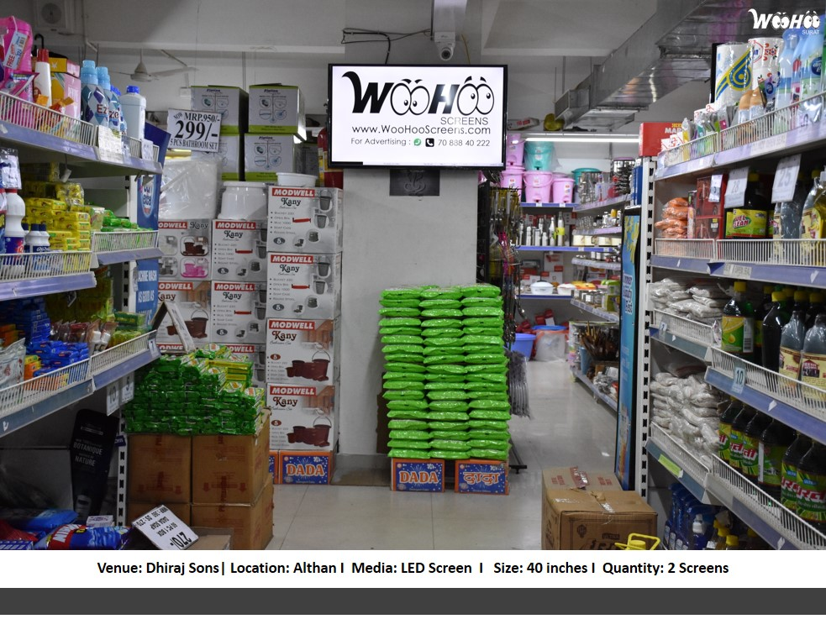

CAMPAIGN DETAILS OF
Site name : 2 Screens at Dhiraj Sons, Althan, Surat
Media Type : LCD Screen
SITE
Name : 2 Screens at Dhiraj Sons, Althan, Surat
Media Type : LCD Screen
City : Surat
Location : Dhiraj Sons, Althan, Surat
GEO Location : 21.149431,72.782777
Size :
Illumination : Ledscreen
Price : 2000.00
Foot fall : 0

Slide 3


