Slide 1


Slide 2
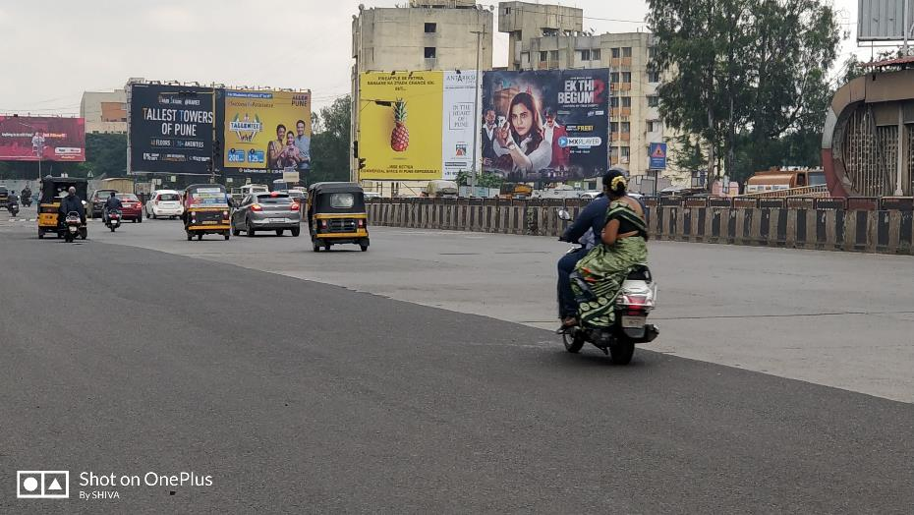

CAMPAIGN DETAILS OF
Site name : Nagar Road Ramwadi Junction (New Airport Junction) FCG Yerwada FRONT ROW No .2 Inner Side
Media Type : Billboard
SITE
Name : Nagar Road Ramwadi Junction (New Airport Junction) FCG Yerwada FRONT ROW No .2 Inner Side
Media Type : Billboard
City : Pune
Location : Nagar Road Ramwadi Junction (New Airport Junction) FCG Yerwada FRONT ROW No .2 Inner Side
GEO Location : null
Size : 1280
Illumination : Frontlit
Price : 220000
Foot fall : 0

Slide 3
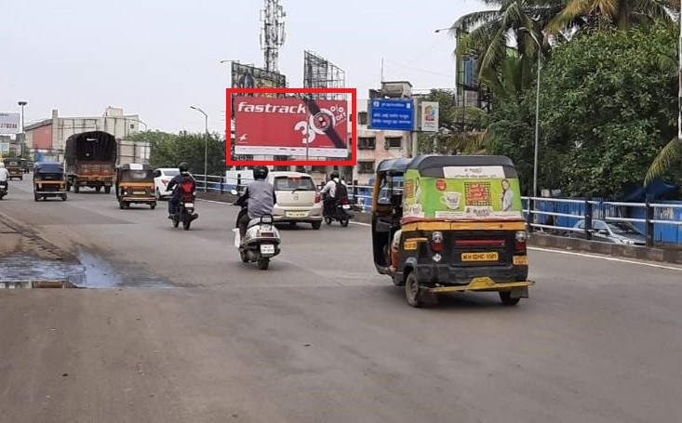
CAMPAIGN DETAILS OF
Site name : Sinhgad Rd. Nr. Funtime Theater traffic coming from Dhyari To Rajaram Bridge
Media Type : Billboard
SITE
Name : Sinhgad Rd. Nr. Funtime Theater traffic coming from Dhyari To Rajaram Bridge
Media Type : Billboard
City : Pune
Location : Sinhgad Rd. Nr. Funtime Theater traffic coming from Dhyari To Rajaram Bridge
GEO Location : null
Size : 800
Illumination : Frontlit
Price : 120000
Foot fall : 0

Slide 4


