Slide 1


Slide 2
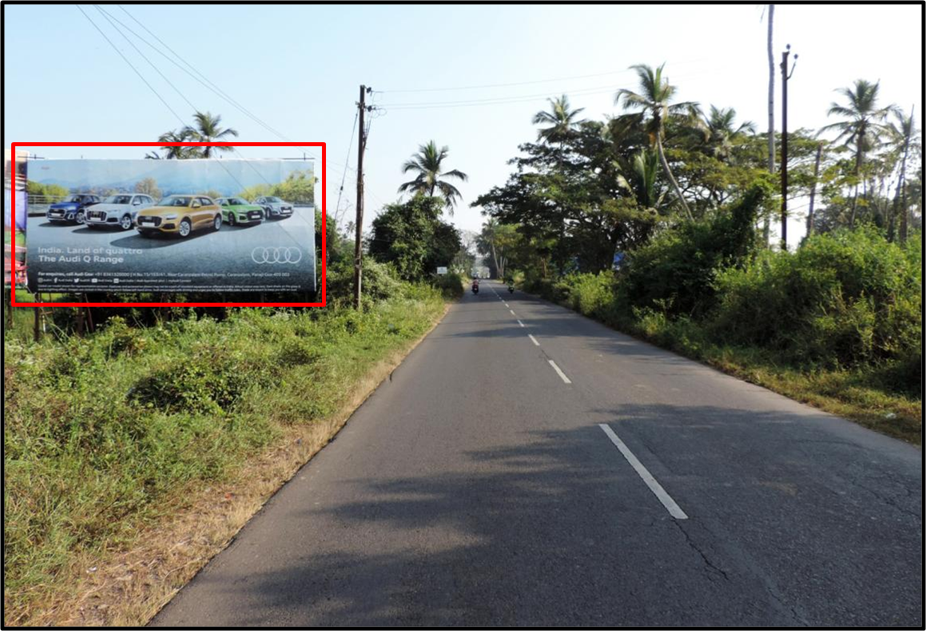

CAMPAIGN DETAILS OF
Site name : Margao Entrance
Media Type : Billboard
SITE
Name : Margao Entrance
Media Type : Billboard
City : Margao
Location : Margao Entrance
GEO Location : null
Size : 820
Illumination : Nonlit
Price : 80000
Foot fall : 0

Slide 3
CAMPAIGN DETAILS OF
Site name : Dilshad Garden Flyover towards Seelampur
Media Type : Unipole
SITE
Name : Dilshad Garden Flyover towards Seelampur
Media Type : Unipole
City : Delhi
Location : Dilshad Garden Flyover towards Seelampur
GEO Location : null
Size : 200
Illumination : Frontlit
Price : 125000
Foot fall : 0

Slide 4


