Slide 1


Slide 2
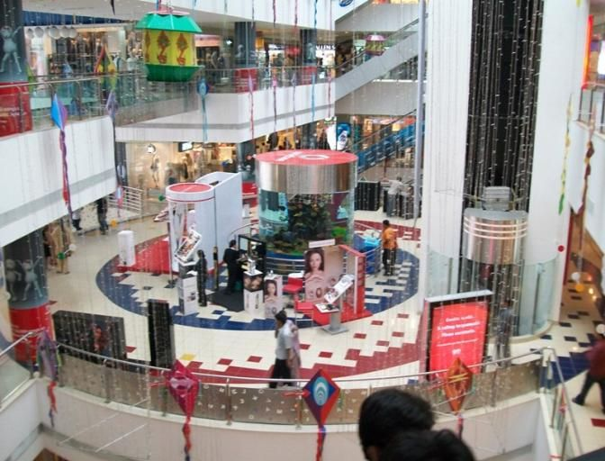

CAMPAIGN DETAILS OF
Site name : GVK One
Media Type : Activation
SITE
Name : GVK One
Media Type : Activation
City : Hyderabad
Location : In the Fish Tank atrium
GEO Location : 17.419263 , 78.448397
Size : 100 Sq. ft.
Illumination :
Price : 176000
Foot fall : 0

Slide 3
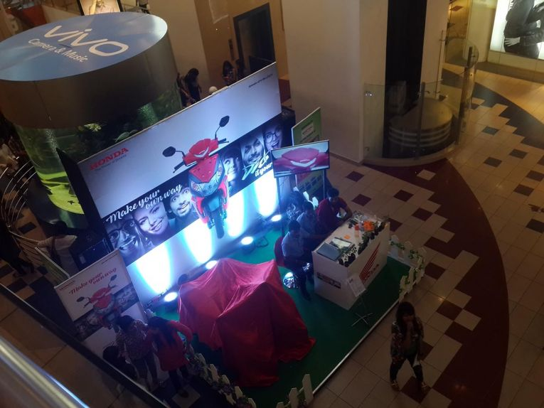
CAMPAIGN DETAILS OF
Site name : GVK One
Media Type : Activation
SITE
Name : GVK One
Media Type : Activation
City : Hyderabad
Location : In the Fish Tank atrium
GEO Location : 17.419294 , 78.448367
Size : 400 Sq. ft.
Illumination :
Price : 198000
Foot fall : 0

Slide 4
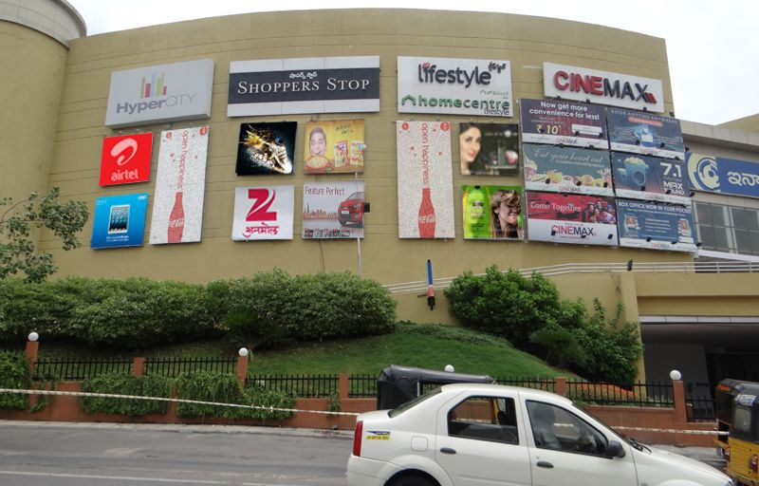
CAMPAIGN DETAILS OF
Site name : Inorbit Mall
Media Type : Facade
SITE
Name : Inorbit Mall
Media Type : Facade
City : Hyderabad
Location : Facade facing main road
GEO Location : 17.433524 , 78.386347
Size : 312 Sq. ft.
Illumination :
Price : 242000
Foot fall : 0

Slide 5


