Slide 1


Slide 2
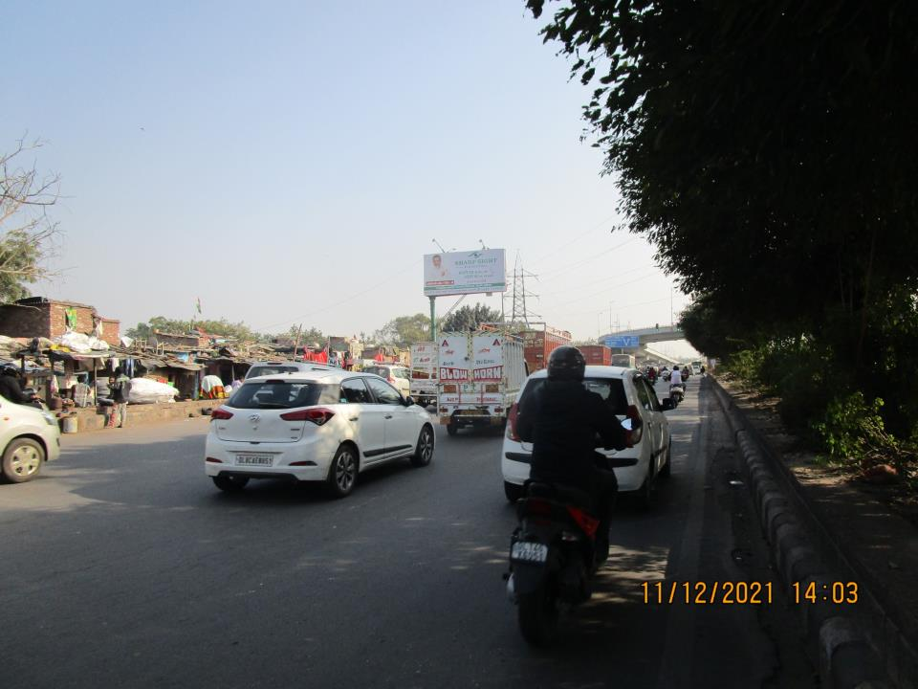

CAMPAIGN DETAILS OF
Site name : Gandhi Nagar Red Light towards Geeta Colony
Media Type : Unipole
SITE
Name : Gandhi Nagar Red Light towards Geeta Colony
Media Type : Unipole
City : Delhi
Location : Gandhi Nagar Red Light towards Geeta Colony
GEO Location : null
Size : 200
Illumination : Frontlit
Price : 125000
Foot fall : 0

Slide 3


