Slide 1


Slide 2
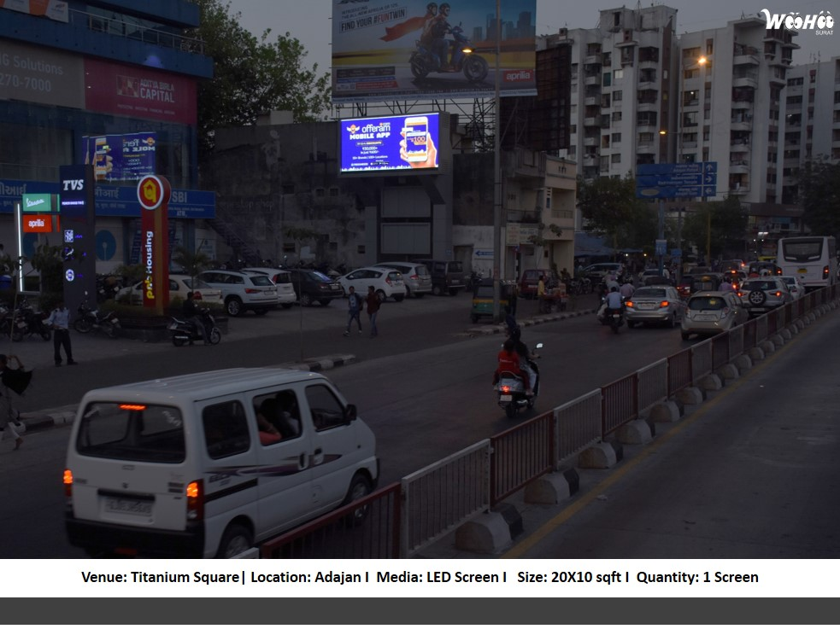

CAMPAIGN DETAILS OF
Site name : Digital Screen at Titanium Square Adajan - Hazira Main Road Surat
Media Type : Smart Boards
SITE
Name : Digital Screen at Titanium Square Adajan - Hazira Main Road Surat
Media Type : Smart Boards
City : Surat
Location : Titanium Square, Adajan - Hazira Main Road, Adajan, Surat
GEO Location : 21.18973,72.795808
Size :
Illumination : Ledscreen
Price : 35000.00
Foot fall : 0

Slide 3


