Slide 1


Slide 2
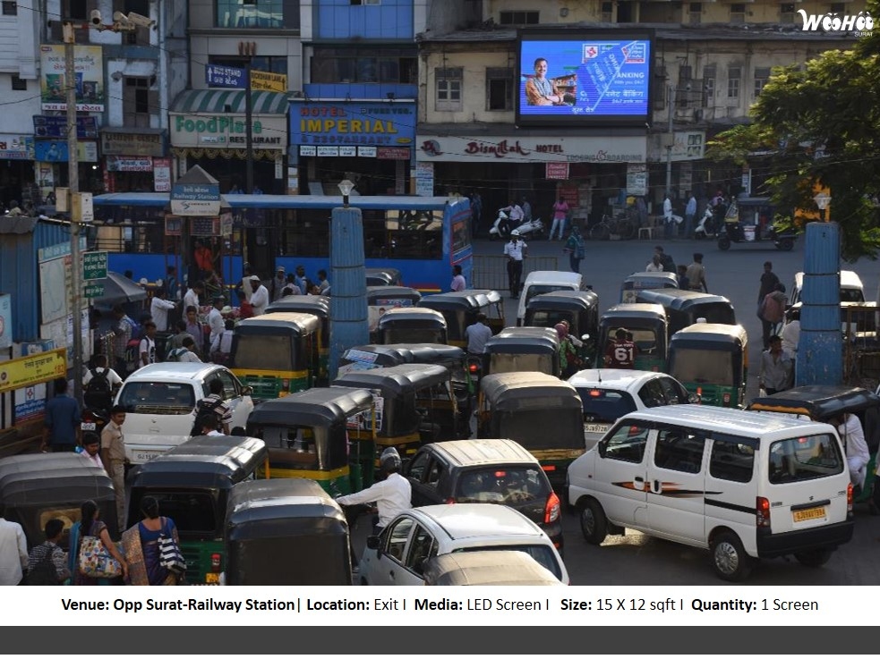

CAMPAIGN DETAILS OF
Site name : Digital Screen Above Bismilla Juice Center, Opp. Exit Gate of Surat Railway Station
Media Type : Smart Boards
SITE
Name : Digital Screen Above Bismilla Juice Center, Opp. Exit Gate of Surat Railway Station
Media Type : Smart Boards
City : Surat
Location : Above Bismilla Juice Centra, Opp. Exit Gate of Surat Railway Station, Surat
GEO Location : 21.204953,72.840796
Size :
Illumination : Ledscreen
Price : 35000.00
Foot fall : 0

Slide 3


