Slide 1


Slide 2
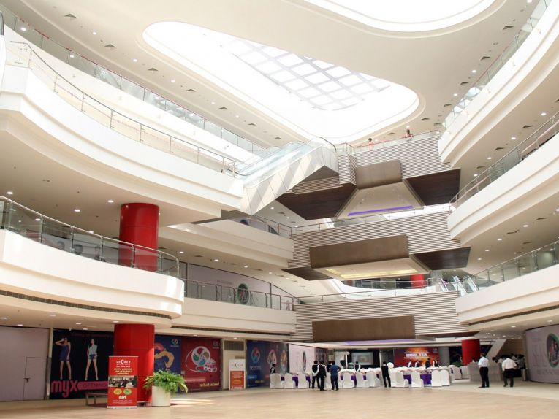

CAMPAIGN DETAILS OF
Site name : Season`s Mall
Media Type : Atrium Drop Down
SITE
Name : Season`s Mall
Media Type : Atrium Drop Down
City : Pune
Location : In the main atrium
GEO Location : 18.519546 , 73.931518
Size : 450 Sq. ft.
Illumination :
Price : 121000
Foot fall : 0

Slide 3


