Slide 1


Slide 2
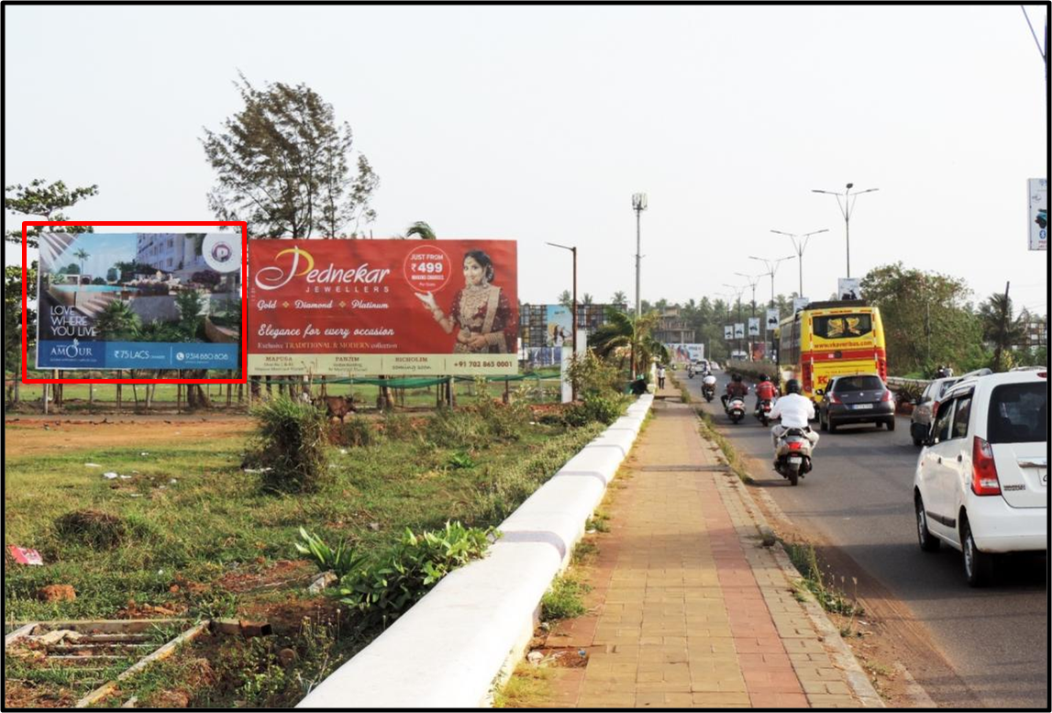

CAMPAIGN DETAILS OF
Site name : Mapusa Entrance
Media Type : Billboard
SITE
Name : Mapusa Entrance
Media Type : Billboard
City : Mapusa
Location : Mapusa Entrance
GEO Location : null
Size : 600
Illumination : Nonlit
Price : 60000
Foot fall : 0

Slide 3


