Slide 1


Slide 2
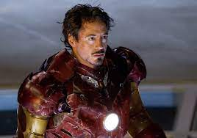

CAMPAIGN DETAILS OF
Site name : india gate
Media Type : Front Facade
SITE
Name : india gate
Media Type : Front Facade
City : Delhi
Location : gyhktyhk
GEO Location : 653
Size : 200 x 200
Illumination : Non-lit
Price : 10000
Available Date : 2023-07-31 00:00:00

Slide 3

CAMPAIGN DETAILS OF
Site name : fg
Media Type : Front Facade
SITE
Name : fg
Media Type : Front Facade
City : Bondila
Location : 1000
GEO Location : 10000
Size : 110 x 110
Illumination : Non-lit
Price : 1000
Available Date : 2023-08-01 00:00:00

Slide 4


