Slide 1


Slide 2
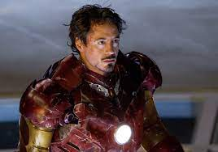

CAMPAIGN DETAILS OF
Site name : india gate
Media Type : Front Facade
SITE
Name : india gate
Media Type : Front Facade
City : Delhi
Location : gyhktyhk
GEO Location : 653
Size : 200 x 200
Illumination : Non-lit
Price : 10000
Available Date : 2023-07-31 00:00:00

Slide 3

CAMPAIGN DETAILS OF
Site name : go odok
Media Type : Front Facade
SITE
Name : go odok
Media Type : Front Facade
City : Amguri
Location : gyhktyhk
GEO Location : 786786
Size : 45 x 45
Illumination : Non-lit
Price : 78000
Available Date : 2023-12-03 00:00:00

Slide 4


