Slide 1
DEPARTMENT OF INFORMATION TECHNOLOGY • MADRAS INSTITUTE OF TECHNOLOGY, ANNA UNIVERSITY
REVIEW 2
Project Progress Presentation
Autonomous AI-Augmented CI/CD Pipeline with
Adaptive Trust-Tiering and Chaos Engineering
Team 18
Praveen Kumar C (2023510023) • Jaiprakash S (2023510027) • Dharshini T (2023510062)
Guided by Dr. P. Anandha Kumar, Professor, Department of Information Technology
1 / 18

Slide 2
REVIEW 1 RECAP
The Problem We Set Out to Solve
Modern CI/CD pipelines rely on static, hardcoded rules and manual SRE effort to triage test failures, verify security risk, and manage rollbacks. Granting an AI agent execution rights over a pipeline is risky without a mathematically sound, stateful trust mechanism.
Literature Gap Identified
No stateful, empirically-calibrated trust model governs AI agent autonomy in CI/CD
Security tools flag CVEs but rarely verify execution reachability
RCA methods are largely reactive, not proactive
No unified framework combines Triage + Trust + RCA in one governed pipeline
Test Flakiness Classification — is a failure a real bug, or a transient glitch worth retrying?
Stateful Trust Governance — how much autonomy has an AI agent actually earned?
Automated Postmortem Generation — where, inside a failing trace, is the actual fault?
2 / 18

Slide 3
REVIEW 1 RECAP
What We Proposed to Build
Six cooperating agents, each independently governed, feeding one policy engine:
1
AI Test-Triage Agent
2
Security Agent
3
Policy Engine
LSTM-based sequential log modeling -> flaky-test classification
Static call-graph reachability -> verified exploitable CVEs
T0-T3 stateful trust-tier evaluation -> execution decision
4
Observability Agent
5
Postmortem Agent
6
Chaos Engineering
Multi-modal telemetry fusion -> canary health score
Causal inference -> incident timeline + remediation PR
Synthetic fault injection -> trust boundary validation
Highlighted: the Triage Agent — the foundation everything else in this review builds on.
3 / 18

Slide 4
WHAT THIS REVIEW DELIVERS
From Proposal to Proven System
01
The Dataset at Scale
Millions of real distributed-system events, honestly counted
02
Triage Model + New Architecture
Attention-pooled BiLSTM, retrained, re-evaluated
03
The Trust-Tier Engine
Statistically gated agent autonomy, T0 -> T3, proven live
04
Root-Cause Analysis
Ranking the exact span responsible for a failure
05
Limitations & What's Next
Reported plainly, not hidden
4 / 18

Slide 5
SECTION 1 · FOUNDATION
The Dataset, at Real Scale
Every number below is measured directly from the working pipeline — nothing projected.
3.0 GB
363
370,000+
raw distributed-system
trace data on disk
fault-injection scenario
folders across 17 fault families
raw traces logged across
the full TraceBench dataset
2,110,221
81,777
61,767
individual timestamped
events baselined for RCA alone
traces clock-aligned
across hosts — 100% success
traces in the final training
corpus (train+val+test)
5 / 18

Slide 6
SECTION 1 · FOUNDATION
Solving Un-Synchronized Clocks Across Hosts
Every event's timestamp is on its OWN host's clock. Two machines' clocks are never aligned — so sorting by raw time gives the wrong order.
BEFORE — raw timestamps
client001 t=1000 → RPC:getFileInfo
namenode t=500000 → getFileInfo
Sorted by raw time: namenode appears to run AFTER a 499000-tick gap — meaningless across two independent clocks.
AFTER — aligned onto one common timeline
client001 aligned=1000 → RPC:getFileInfo (depth 1, caller)
namenode aligned=1000 → getFileInfo (depth 2, handler)
offset[namenode] = -499,000, computed from edge.csv's own FatherStartTime — no external clock sync assumed.
Result: 81,777 / 81,777 traces (100%) fully aligned — the true root operation is recovered every time.
6 / 18

Slide 7
SECTION 2 · MODEL ARCHITECTURE CHANGE
New Architecture: Attention-Pooled BiLSTM
Replaced “just use the network's last output” with a learned, per-timestep importance score — so the failing span dominates the summary, wherever it sits in the sequence.
✗ PHASE 1 — Last Hidden State
✓ OUR MODEL — Attention Pooling
op1
op2
op3
ERR
PAD
PAD
PAD
op1
op2
op3
ERR
PAD
PAD
PAD
0.05
0.08
0.07
0.8
0
0
0
→ only the FINAL output is used as the summary
→ EVERY real step votes, weighted by learned importance
only h_n used
Σ wᵢ · hᵢ (weighted sum)
Problem: the final state is mostly memory of PAD steps, not of the real ERR event — signal gets diluted and lost.
Benefit: the ERR span dominates the summary (weight 0.80), PAD contributes ~0, and the weights double as evidence spans shown to the user.
7 / 18

Slide 8
SECTION 2 · MODEL ARCHITECTURE CHANGE
The Mechanics, Step by Step
1
2
3
4
→
→
→
Score
Mask
Weight
Pool
Every real timestep gets a learned
importance score
Padding is forced to -infinity,
becomes exactly 0 after softmax
Softmax turns scores into
weights that sum to 1
Weighted sum of every timestep
= the trace's summary vector
scores = self.att(out).squeeze(-1) # 1. raw score per timestep
scores = scores.masked_fill(~mask, -inf) # 2. padding -> -infinity
w = torch.softmax(scores, dim=1) # 3. scores -> weights (sum to 1)
attended = torch.bmm(w.unsqueeze(1), out).squeeze(1) # 4. weighted-average summary
Why this matters:
The same weights double as “evidence spans” returned by the API — the model can point at exactly which operation drove its decision, instead of being a black box.
8 / 18

Slide 9
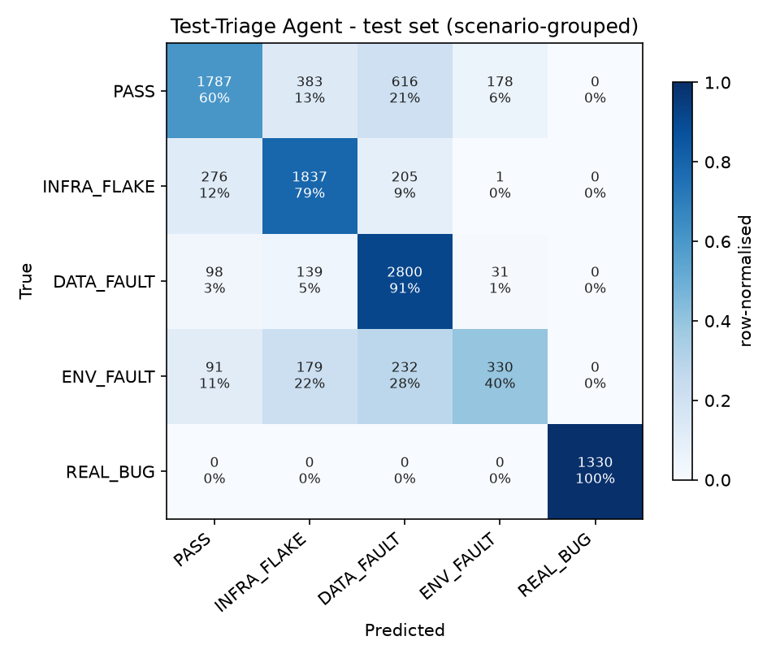
SECTION 2 · RESULTS
Results on the Held-Out Test Set
10,513 real traces the model never saw during training, from 57 scenario folders also never seen (grouped split).
Class | Precision | Recall | F1
PASS | 0.79 | 0.60 | 0.69
INFRA_FLAKE | 0.72 | 0.79 | 0.76
DATA_FAULT | 0.73 | 0.91 | 0.81
ENV_FAULT | 0.61 | 0.40 | 0.48
REAL_BUG | 1.00 | 1.00 | 1.00
macro-F1 = 0.746 | accuracy = 76.9%
139 / 10,513 decisions (1.3%) wrongly retried
Zero REAL_BUG misses across the entire test set
REAL_BUG's perfect score is a workload-length confound — stated plainly, not hidden
9 / 18

Slide 10
SECTION 2 · TRAINING IMPROVEMENT
Fixing ENV_FAULT — A Real, Reported Trade-off
ENV_FAULT's class weight over-corrected, making it a false-positive magnet. Softening the weight formula (--weight-power 0.5) traded recall for precision:
Honestly, not solved:
612 PASS + 736 DATA_FAULT + 203 INFRA_FLAKE false alarms BEFORE
Only 210 total false alarms AFTER — but recall dropped
Whether precision or recall matters more for QUARANTINE_NODE is a real, open policy question
10 / 18

Slide 11
SECTION 3 · TRUST-TIER ENGINE
Four Levels of Earned Autonomy
An AI agent should not be trusted with high-stakes pipeline actions from day one. Trust is earned, tier by tier, and can be taken away instantly.
T3
T2
T1
T0
Observe Only
Recommend
Act with Rollback
Act Autonomously
Agent watches and logs — never acts
Agent suggests; a human approves
Agent acts; the action can be undone
Highest-stakes actions, no human step
11 / 18

Slide 12
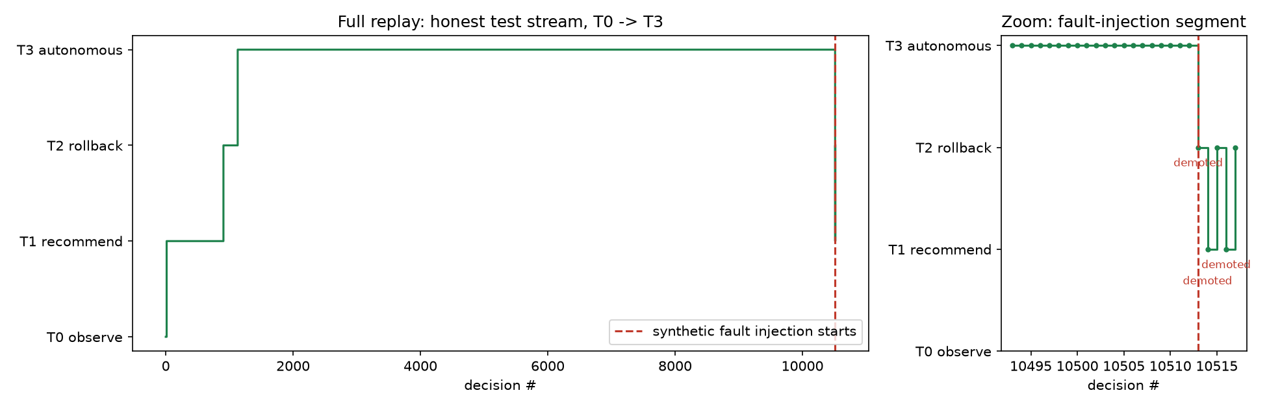
SECTION 3 · TRUST-TIER ENGINE
Promotion Backed by Real Statistics
Raw accuracy ("17/20 = 85%") isn't safe to promote on — 20 samples could really mean 65%-95% true accuracy. Promotion is gated on the Wilson lower-bound instead: the worst accuracy still consistent with the evidence, at 95% confidence.
wilson_lower_bound(k, n, z=1.96):
Demotion is instant and asymmetric:
return (centre - spread) / denom
A single missed REAL_BUG acted on autonomously drops the agent one tier immediately - no averaging, no waiting.
17/20 → floor ~0.64 (not enough) | 850/1000 → floor ~0.83 (enough)
Proof — replaying 10,513 real test decisions through the live engine:
12 / 18

Slide 13
SECTION 3 · TRUST-TIER ENGINE
From Classification to Pipeline Action
A pure, fully unit-tested decision function — no side effects — turns a class + trust tier into a concrete action.
Class | Action | Min. tier to act alone
PASS | ALLOW_MERGE | T2
INFRA_FLAKE | AUTO_RETRY_PIPELINE (budgeted) | T2
DATA_FAULT | ESCALATE_TO_INFRA — never retry | T1
ENV_FAULT | QUARANTINE_NODE | T3
REAL_BUG | BLOCK_MERGE_ALERT_DEV | T1
Also expressed in Rego
Same rules, written for Open Policy Agent (OPA) — the industry-standard policy language
Lets the decision run inside a CI step directly, outside Python
Checked for agreement with the Python logic by an automated equivalence test
Why a pure function?
No I/O, no side effects, no model calls inside it — the decision engine only decides, an actuator executes separately. That separation is what makes the trust tiers meaningful, and it is why this logic is trivial to unit test exhaustively.
13 / 18

Slide 14
SECTION 4 · ROOT-CAUSE ANALYSIS
Pointing at the Exact Cause, Not Just Pass/Fail
A classification alone still leaves a developer hunting through dozens of operations. This module ranks every span in a failing trace by how suspicious it looks.
1
2
3
Baseline
Score
Rank
Learn normal duration (mean, std) for every op — from 2,110,221 events in healthy PASS traces
z = (duration - mean) / std, plus a bonus if the span's own status is an error
Sort every span by score, descending — the top is the best place to look first
z = (duration - baseline_mean) / baseline_std # how abnormal is the timing?
err = status not in ("OK", "USER")
score = max(z, 0) + (2.0 if err else 0.0) + 0.25 * depth_bonus
14 / 18

Slide 15
SECTION 4 · ROOT-CAUSE ANALYSIS
Beats Random and Slowest-Span Baselines, Decisively
Top-1 localization accuracy across 10,411 test-set traces with a real, observable error span:
Reported honestly:
DATA_FAULT localization (0.26 top-1) is the weak spot — far better than guessing, but not yet reliable enough to skip a human double-check.
Example: for a real DATA_FAULT trace, the top suspect chooseDataNode ran ~5 standard deviations slower than baseline.
15 / 18

Slide 16
SECTION 5 · REPORTED PLAINLY
Limitations — Not Hidden, By Design
Phase 1's biggest failure was a single accuracy number (88.18%) that hid a broken model . Every known weakness here is stated the same way that mistake should have been caught.
ENV_FAULT remains the hardest class (F1 = 0.48)
The precision/recall trade-off is real and not yet fully resolved
COMPOUND traces (multi-fault) still mostly classified PASS
About 78% of the time — held out deliberately as a generalisation probe
DATA_FAULT root-cause localization is weaker
0.26 top-1 vs 0.59-0.82 for other classes
Attention weights have partly collapsed
Evidence spans from /triage are not yet fully reliable (postmortem uses a separate, unaffected method)
Sequence order carries little extra signal
An order-free baseline performs almost as well — reported as a genuine finding, not hidden
This is the same discipline the whole project is built on:
Phase 1 hid a broken model behind one accuracy number . Every number and weakness in this review is reported the way that one should have been.
16 / 18

Slide 17
ROADMAP
What's Next - Scoped for What We Can Finish
Remaining workstreams, deliberately scoped down from heavy infrastructure to a lightweight version that proves the same idea:
Planned piece | Lightweight version chosen
Observability (live tracing) | Adapter converting Jaeger/OpenTelemetry traces into the format this model already reads
Security / CVE scanning | pip-audit for known vulnerabilities + a simple reachability check
Chaos Engineering | A plain fault-injection script feeding the trust engine's already-proven demotion path
CI Actuator | One GitHub Actions workflow calling the live API, posting the decision as a PR comment
None of this is a scope cut in disguise:
Each substitute proves the same idea the original heavy-infrastructure plan promised, at a fraction of the deployment risk for a 3-person team.
17 / 18

Slide 18
THANK YOU
Questions & Discussion
Team 18 · Autonomous AI-Augmented CI/CD Pipeline with Adaptive Trust-Tiering and Chaos Engineering
18 / 18

