Slide 1
Autonomous AI-Augmented CI/CD Pipeline with Adaptive Trust-Tiering and Chaos Engineering
Final Review · Team 18
Praveen Kumar C · Jaiprakash S · Dharshini T
Guide: Dr. P. Anandha Kumar · Department of Information Technology, MIT, Anna University
Notes:
Welcome. This is the final review of our project: an AI agent that triages failed CI/CD runs and decides how much it may do on its own.

Slide 2
Where we started, and what the final phase added
Review | What we showed | Honest limitation then
Review 1 | Phase 1 LSTM, reported 88.18% | It equalled a one-column rule: counts fed in as token ids
Review 2 | Clock-aligned data, attention BiLSTM, trust tiers, root-cause ranking | Offline only; one data set; no live system
Final | Release gate (drift, canary, security, chaos, actuator), live system, dashboard, comparison with published models | Workflows and Grafana stack written, not executed
Rule we followed: report weak numbers as plainly as strong ones.
2
Notes:
Review 1 reported 88 percent, which turned out to be a one-column rule. Review 2 rebuilt the foundation. The final phase made it a runnable, measured, honest system.

Slide 3
The problem: four failures that look the same
The run failed because of... | Class | Right response | Needs trust tier
A transient network or process fault | INFRA_FLAKE | Retry (budget 2) | T2
Corruption or data loss | DATA_FAULT | Escalate, never retry | T1
A failing host | ENV_FAULT | Quarantine the node | T3
A genuine defect | REAL_BUG | Block merge, alert developer | T1
Nothing wrong | PASS | Allow merge | T2
Second question: how much may the agent do alone? We answer it from its measured track record.
3
Notes:
On a dashboard they are all a red run, but the right response differs completely. Retrying a corruption wastes time. Merging a bug ships it.

Slide 4
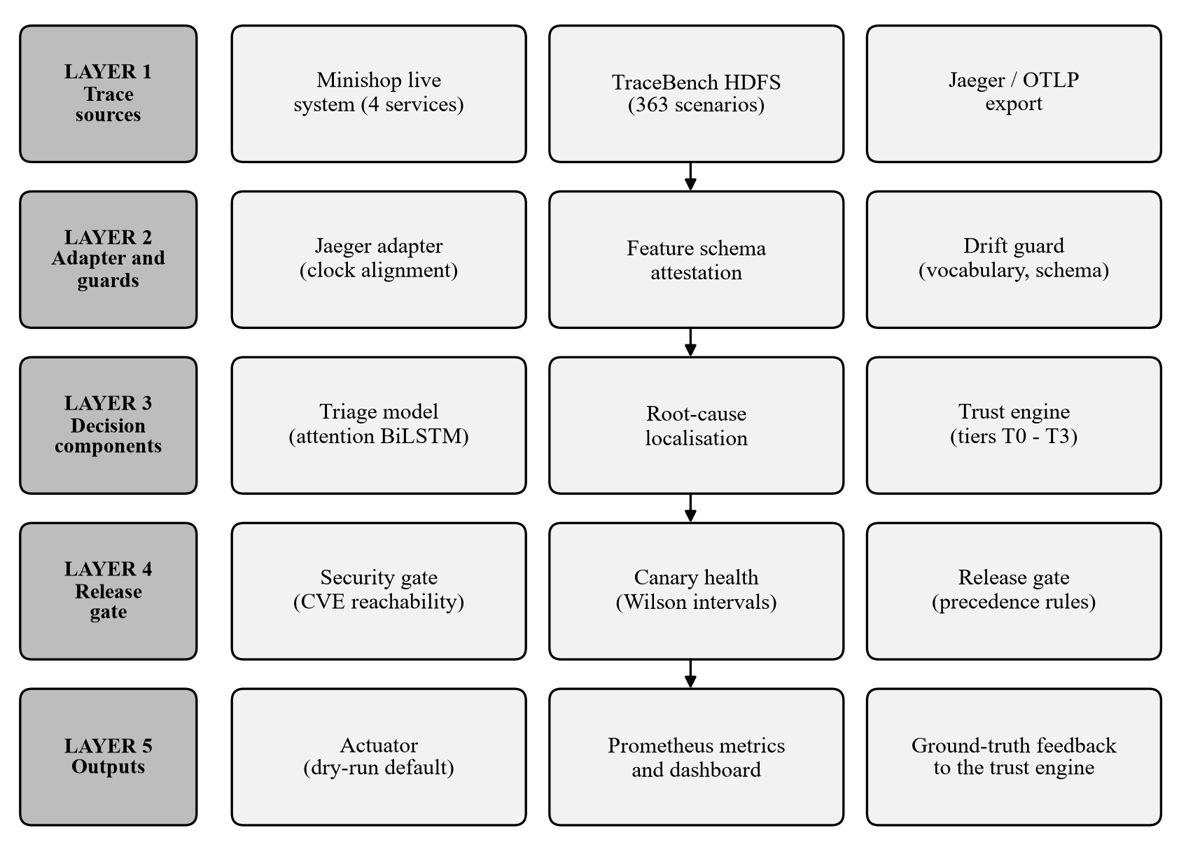
System architecture: five layers
Deciding and executing are separate
Prefers to abstain: unknown trace, thin canary, low confidence all go to a human
One function serves the API, CI gate and dashboard
4
Notes:
Traces come in, are normalised and checked, classified, combined with security and canary signals, and the decision is executed in dry-run mode. The true outcome flows back to the trust engine.

Slide 5
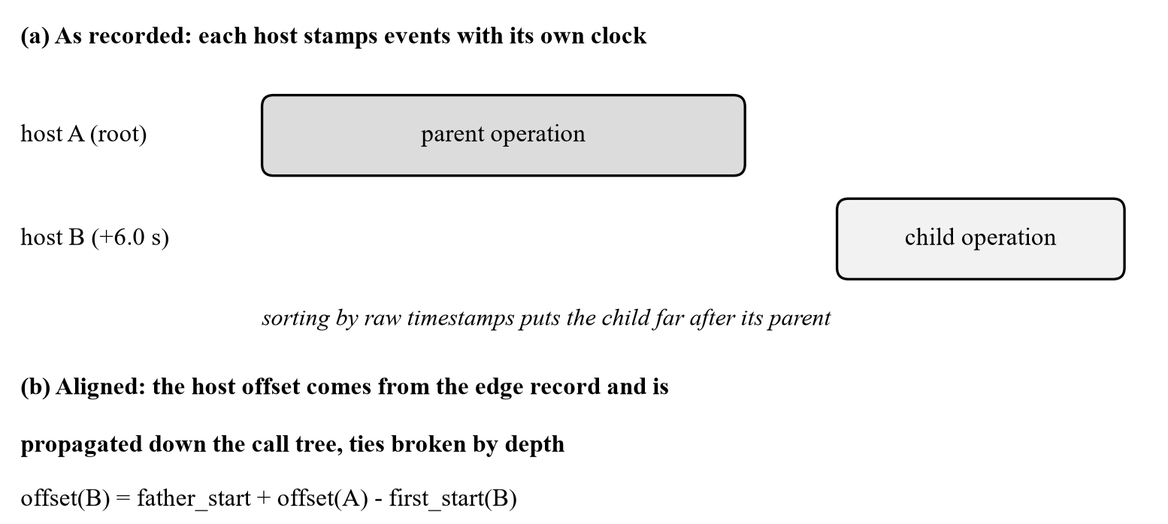
Data foundation: real traces, clocks fixed, no leakage
81,777
363
traces, all align
scenario folders, 3.0 GB
57
10,513
held-out test scenarios
test traces
Offset of a host = parent's clock reading minus child's first reading, propagated down the call tree
Class from the scenario family; compound faults (20,010 traces) held out as a probe
Task title is not a model input: it leaks the scenario
5
Notes:
TraceBench HDFS. The hosts disagree on time, so we recover each host's offset from the parent-child edge records. We split by scenario so the test set measures generalisation.

Slide 6
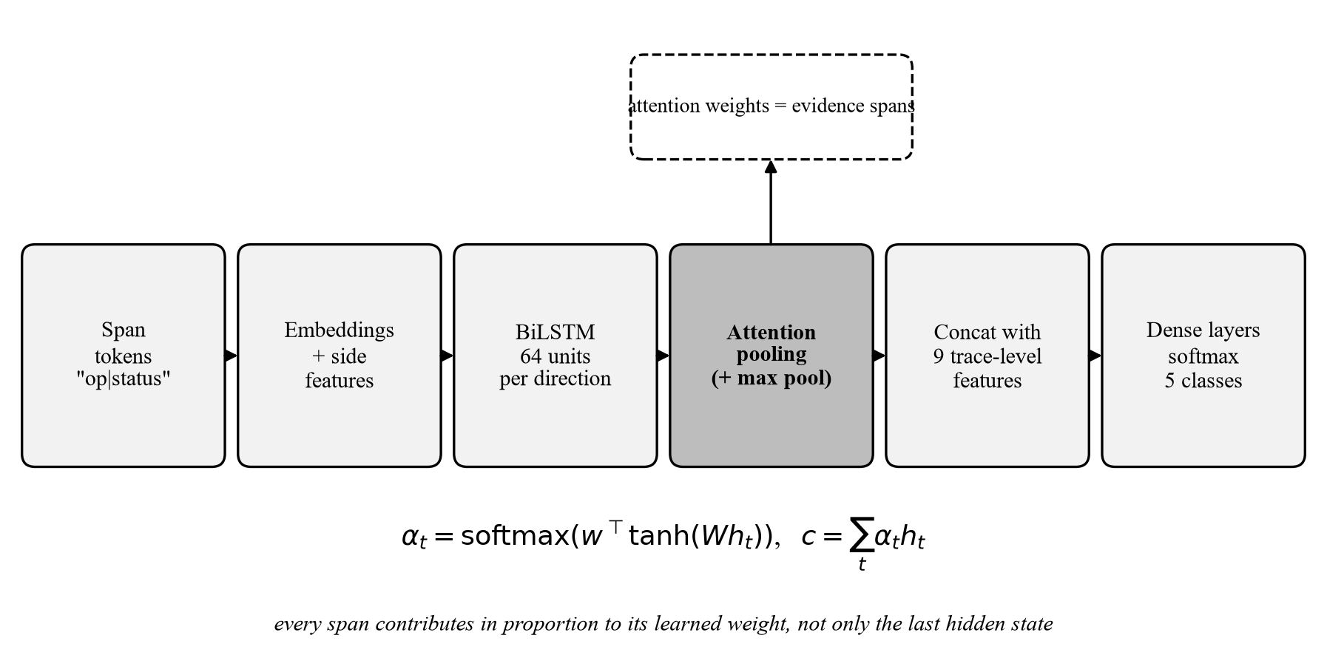
The model: attention-pooled BiLSTM
Inputs per span: operation|status, host role, agent type, depth, duration; plus 9 trace-level features
125,430 parameters, trained on CPU in 24 minutes
Evidence spans are a hint, not proof: two attempts to regularise attention were rejected
6
Notes:
Instead of keeping only the last state, attention lets every span contribute with a learned weight. The weights also tell us which spans drove the decision.

Slide 7
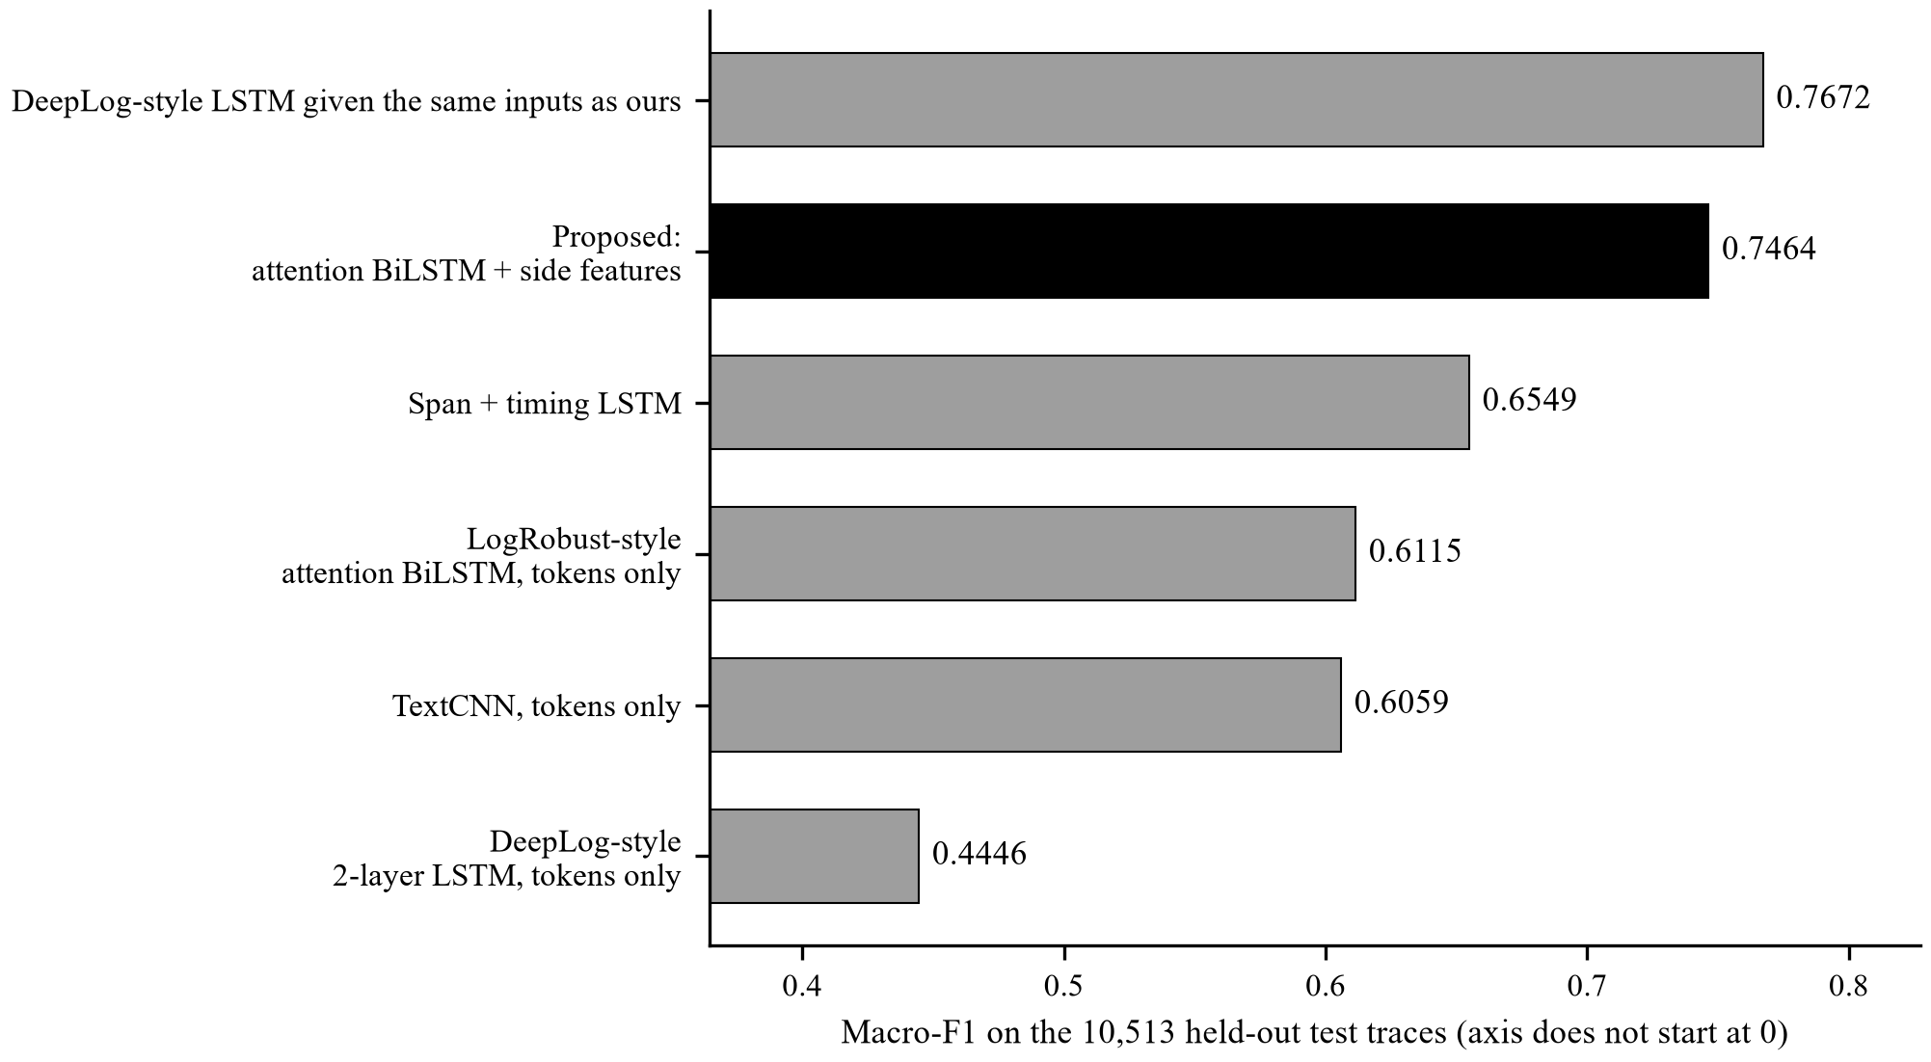
Comparison with published architectures (same data, same split)
Model | Macro-F1 | Excl. REAL_BUG | Params
DeepLog-style LSTM given the same inputs as ours | 0.7672 | 0.7090 | 88,437
Proposed | 0.7464 | 0.6829 | 125,430
Span + timing LSTM | 0.6549 | 0.6483 | 35,749
LogRobust-style | 0.6115 | 0.6014 | 71,510
TextCNN, tokens only | 0.6059 | 0.5980 | 32,981
DeepLog-style | 0.4446 | 0.3930 | 66,965
Proposed vs best competitor: -0.0208 macro-F1
Competitors are re-implementations adapted to our 5-class task; single run each. With identical inputs, a plain 2-layer LSTM matches ours: inputs matter more than architecture here.
7
Notes:
We re-implemented four published architectures and trained them on our split with the same recipe. Our model reaches 0.7464; the best competitor is DeepLog-style LSTM given the same inputs as ours at 0.7672. These are re-implementations, one run each, and the papers report on other data, so this is a like-for-like comparison on our data, not a comparison with the papers' own numbers.

Slide 8
How the comparison was made, and how to read it
Model | Based on | Reads | Classifies with
DeepLog-style | Du et al., CCS 2017 | tokens | 2-layer LSTM, last state
LogRobust-style | Zhang et al., FSE 2019 | tokens | attention BiLSTM
Span + timing LSTM | after Nedelkoski et al., 2019 | tokens + duration | LSTM, last state
TextCNN | Kim, EMNLP 2014 | tokens | conv 2/3/4 + max-pool
DeepLog-style, our inputs | Du et al. backbone | same inputs as ours | 2-layer LSTM, last state
Proposed | this work | tokens + host, agent, depth, duration + 9 features | attention BiLSTM + max-pool
Same split, seed, optimiser, class weights and early stopping for every model
Three competitors see only operation tokens; one adds timing; one gets exactly our inputs, to separate input from architecture
The order-free gradient-boosting baseline (0.7037) already shows this data rewards counts over sequence structure
One run each: small differences are within seed noise
8
Notes:
Fairness points: same split, seed, optimiser, class weights, early stopping. The span-and-timing model is included so we can see how much of any advantage is just richer input.

Slide 9
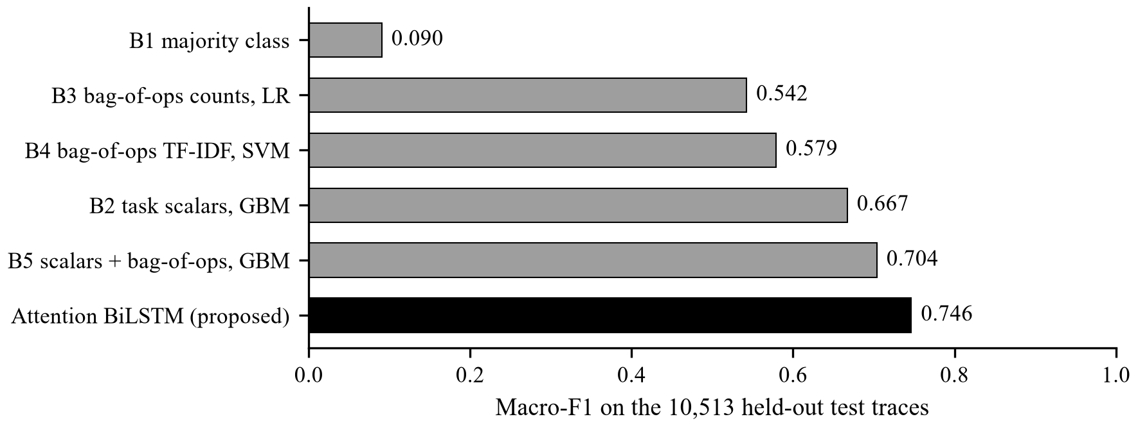
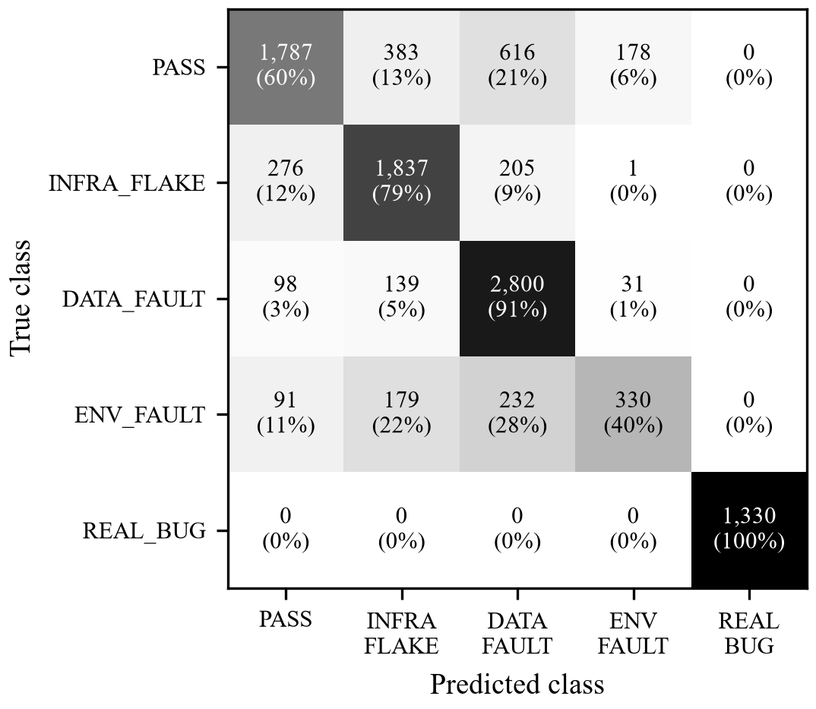
Results on 10,513 unseen traces
0.7464
0.7690
macro-F1
accuracy
0.6829
0
macro-F1 excl. REAL_BUG
real bugs missed
DATA_FAULT recall 0.913; INFRA_FLAKE 0.792
PASS recall 0.603: about 40% of healthy traces flagged
ENV_FAULT is the weak class (F1 0.481)
9
Notes:
Our model beats the count-based representation Phase 1 used by a wide margin, and the strongest order-free baseline by about four points.

Slide 10
What the numbers really say
REAL_BUG = 1.000 is a workload effect: those traces are short (median 7 spans, 2 hosts vs 88–134 spans, 9–12 hosts). We quote 0.6829 excluding it.
Order carries little signal: an order-free baseline ties the BiLSTM on the other four classes; shuffling tokens did not hurt.
Compound faults mostly fail: 77.8% of 20,010 multi-fault traces were called PASS.
Architecture is not what wins: a plain 2-layer LSTM given our exact inputs scores 0.7672, slightly above our 0.7464. The gain comes from the inputs (timing, host, trace features).
Stock Jaeger exports of our own traces were misjudged 4 times in 5 (20% accuracy, 90% called REAL_BUG), so the drift guard also demands an attested feature schema.
Root-cause ranking is weak for data faults (top-3 47.6% vs random 38.1%) and is measured against a proxy label.
10
Notes:
These are the three things we do not want the panel to discover on their own.

Slide 11
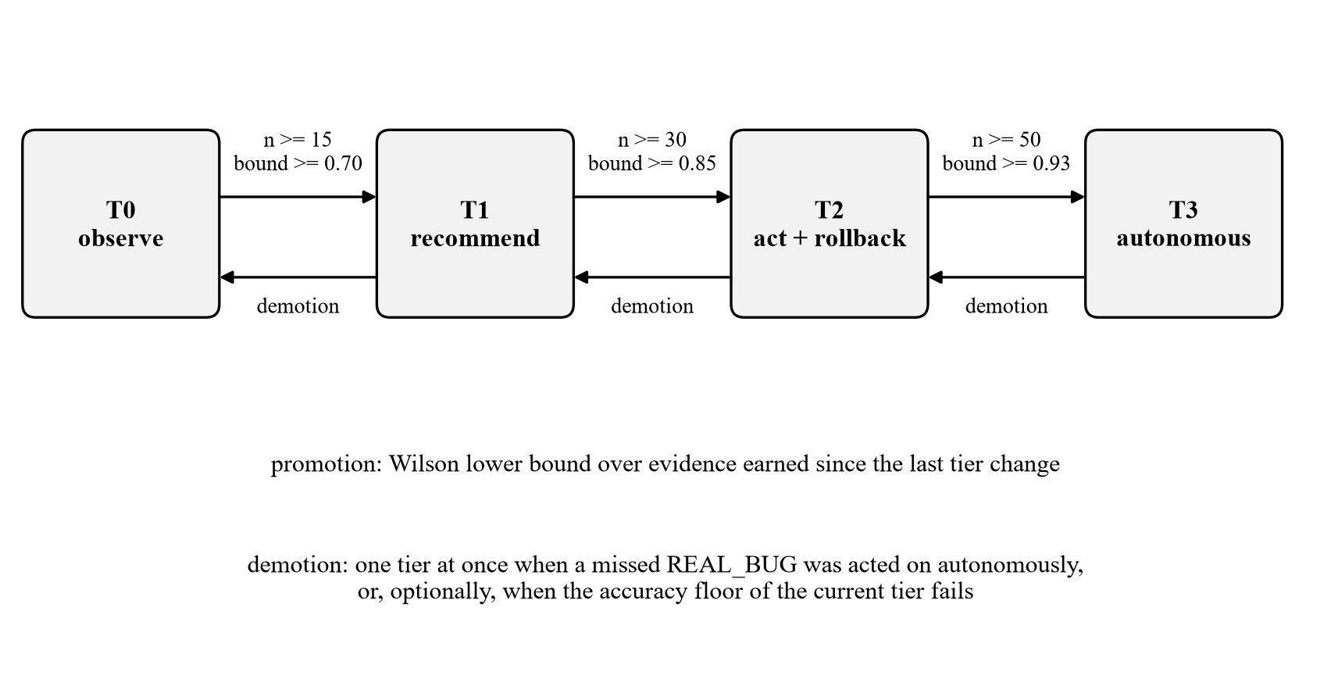
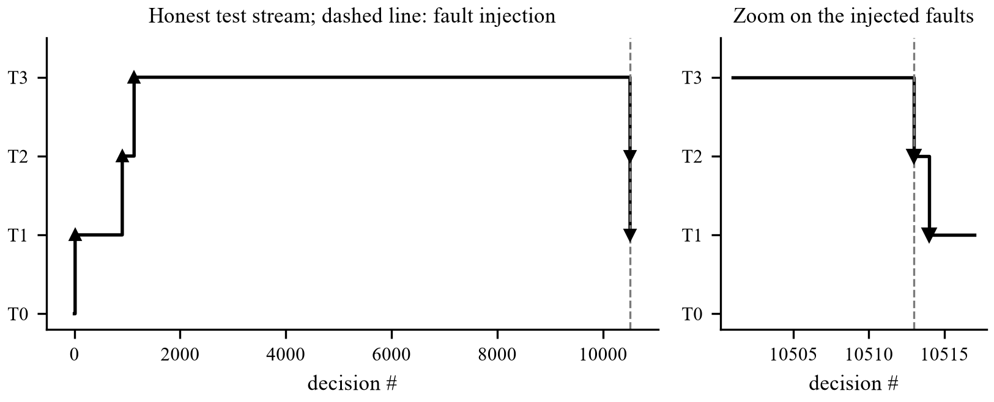
Trust engine: autonomy is earned and can be lost
Wilson bound: 17/20 correct is 85%, but the bound is 0.64
Replay on the test stream: T1 at decision 14, T2 at 906, T3 at 1,130
Injected faults: demoted twice at once
Bug found by the live run: tiers flipped 53 times in 50 decisions; fixed by counting only evidence since the last change
11
Notes:
Promotion needs the Wilson lower bound of accuracy to clear a threshold on fresh evidence. A single missed real defect that was acted on autonomously costs a tier immediately.

Slide 12
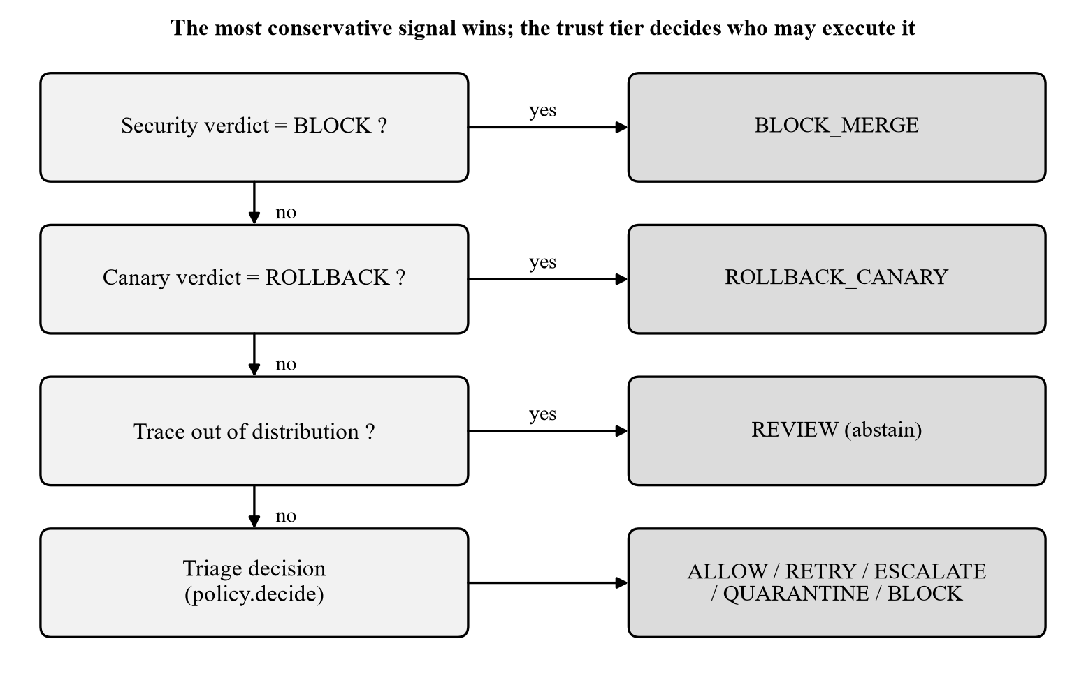
Release gate: the most conservative signal wins
Module | Measured
Drift guard | foreign trace: OOV 1.0, routed to a human
Canary | slow DB 16.7–20.9× p95, rolled back
Security | 27 flagged, 0 reachable
Chaos | silent bug: 0% correct, 2 unsafe merges, T3→T0
Actuator | dry-run default, argv-only, validated names
12
Notes:
Security first, then canary, then abstain-if-unfamiliar, then the triage decision. The tier then decides who may execute it.

Slide 13
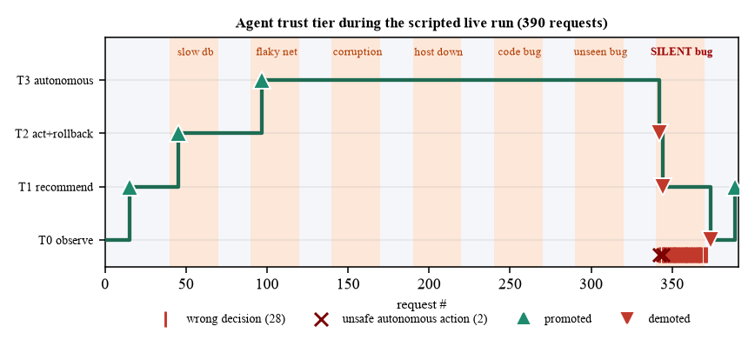
Live closed loop: 390 requests, faults injected on a schedule
92.8%
2
correct decisions
unsafe actions
Promoted at requests 15, 45, 97 → T3
Silent bug (looks healthy): 3 of 30 right; demoted at 342, 344 and by the retention check at 374
Regained T1 at 389 after 15 correct decisions
A toy system: the scalar baseline also scores 1.000 here
13
Notes:
The agent starts with no autonomy, earns T3, is wrong on the silent bug, loses autonomy, and regains it only through new evidence. 362 of 390 correct.

Slide 14
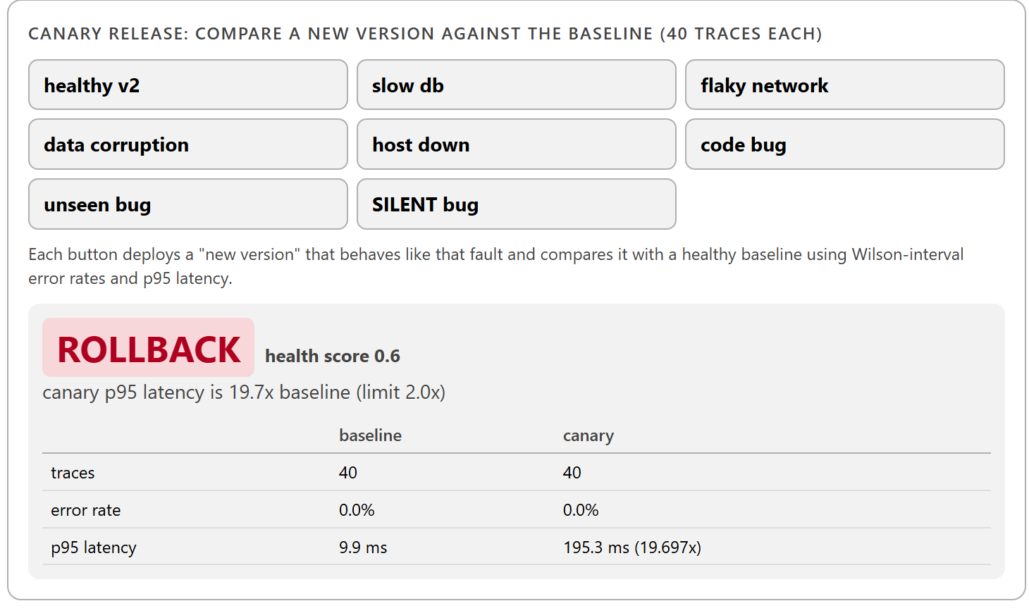
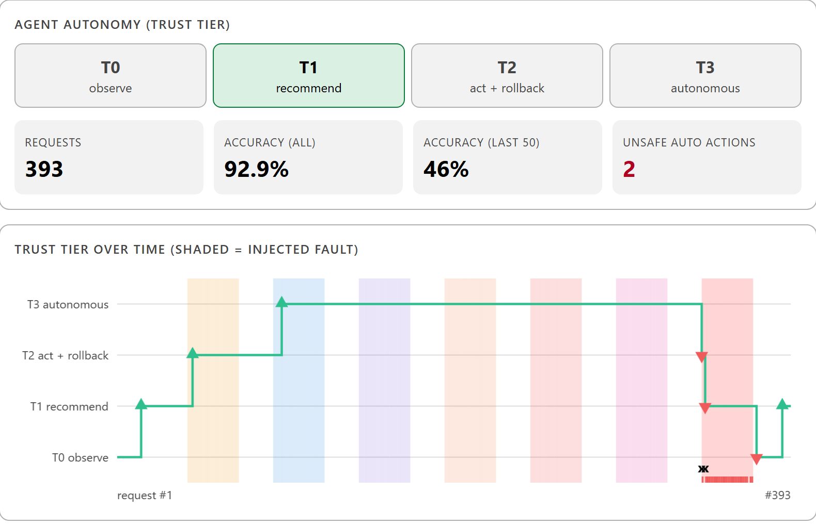
Live demo: the dashboard
Inject faults, run the scripted demo, switch on the chaos monkey
Canary: deploy a new version and watch the gate roll it back
Security, root-cause, real-data and metrics tabs
python scripts/serve_ui.py → http://127.0.0.1:8765
14
Notes:
Start with python scripts/serve_ui.py. The strip along the top is the whole pipeline. Fault buttons inject real faults; the tier chart moves live.

Slide 15
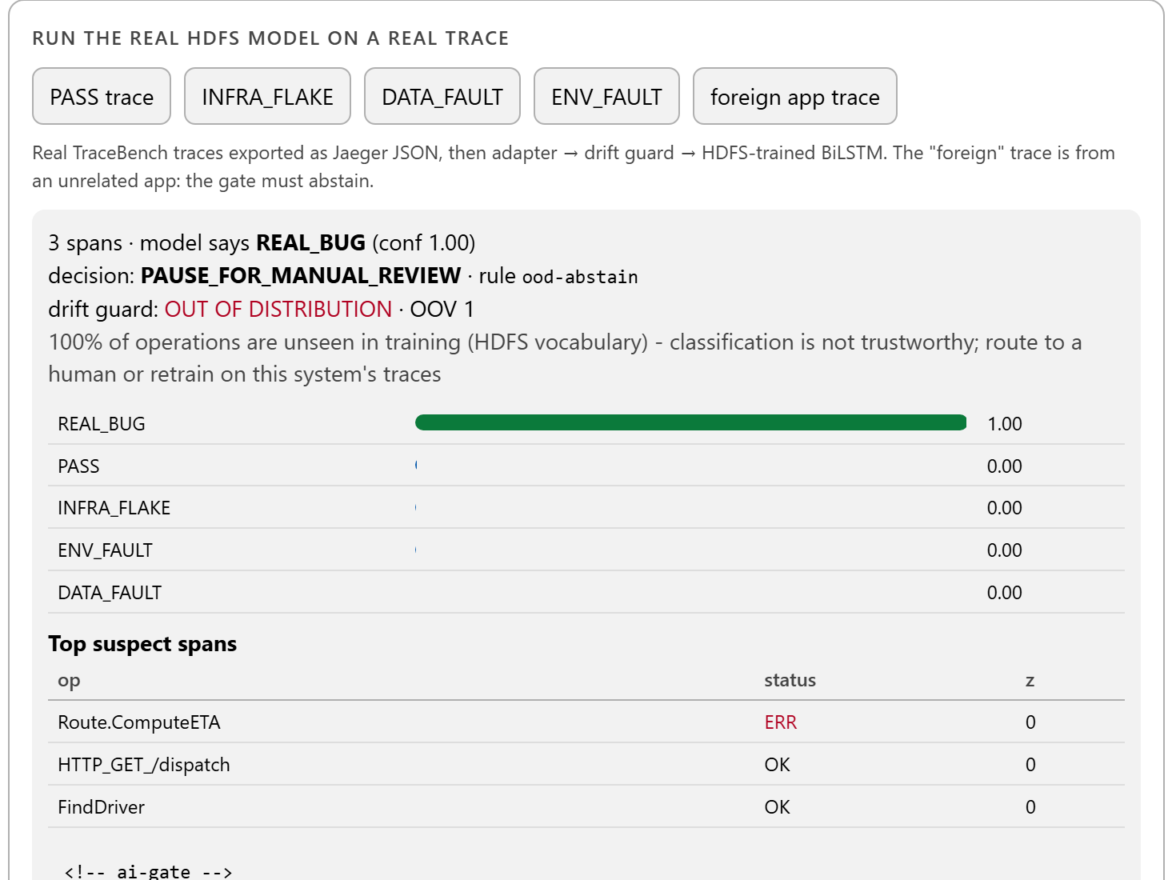
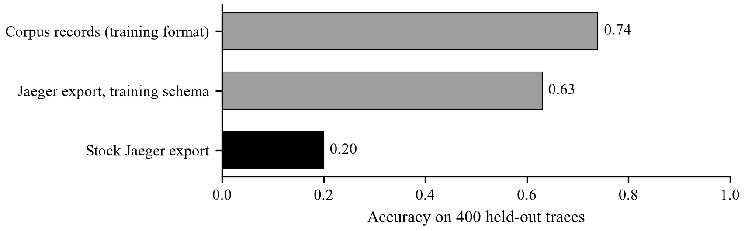
Knowing what it does not know
Corpus records 0.74 → attested export 0.63 → stock export 0.20
Unknown vocabulary (OOV > 0.5) or unattested schema: ask a human
The real Jaeger 1.76.0 round trip works: traces pushed over OTLP, read back, judged in-distribution
15
Notes:
The model only understands HDFS traces in the training schema. Rather than guess elsewhere, the gate abstains.

Slide 16
Problems that measurement exposed
Finding | Fix
88.18% was a one-column rule | Rebuilt from sequences; per-class metrics and baselines
Live test accuracy 1.0 with classes missing | Scenario assigned once by dominant fault class
53 tier flips in 50 decisions | Only evidence since the last tier change counts
Stock exports judged at 20% accuracy | Feature-schema condition in the drift guard
Attention made uniform by regularisation | Rejected; spans reported as a hint
localhost cost 2.1 s per call on Windows | Scripts use 127.0.0.1 (26 ms)
16
Notes:
Several of our best results were bugs we found because we measured.

Slide 17
Limitations and future work
Limitations
Next steps
Valid only for HDFS traces in the training schema
Credible accuracy is 0.6829, not 1.000
No measured gain from attention over a plain LSTM on the same inputs
Root-cause numbers use a proxy label
Workflows, Grafana/Prometheus and real-infrastructure chaos not executed
Comparison models are re-implementations, one run each
Train on a real microservice system with several scenarios per class
Cut false alarms (40% of healthy traces)
Multi-label output for compound faults
Signals outside the trace for silent defects
Run the unexecuted infrastructure; keep the gate advisory until T2
17
Notes:
We state these ourselves. The future work follows directly from the limitations.

Slide 18
Conclusion
A trace-based triage agent that maps five failure classes to pipeline actions
Macro-F1 0.7464 on unseen scenarios; the best re-implemented competitor (DeepLog-style LSTM given the same inputs as ours) reaches 0.7672
A trust engine that grants autonomy from a statistical bound and withdraws it at once on a missed defect
A release gate, live system and dashboard that show the whole loop, including where it fails
183 automated tests; every limit stated
Thank you · Questions?
18
Notes:
Close on the main idea: autonomy should be earned from evidence, and every limit should be measured.

