Slide 1
COMPUTER GRAPHICS PROJECT
TOPIC: PONG SOCCER GAME
HAKAN BACANAK 181180010
AHMET BURHAN TURHAN 161180060
GÖKAY DİNDAR 181180024

Slide 2
PONG SOCCER GAME

Slide 7
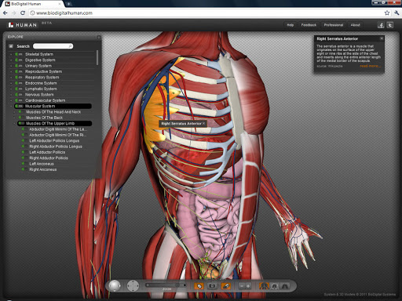
BioDigital Human

Slide 8
BioDigital Human

Slide 9
THANKS FOR LISTENING

